Slide 1
Current: $26.36 Target Price $43.35 (+64%) Time Horizon: 18-24 months
Ballard Power Systems, Inc. (NASDAQ: BLDP)
Directors: Amelia Lin, Sarah Ziegler
Analysts: Carl Aller, Shaun Ge, Christian Geheres, Helena Macrigiane, Matthew Szell, Yuchen Ye

Slide 2
Company Overview
Business Description
Ballard Power Systems Inc. is a Canadian-based developer and manufacturer of hydrogen fuel cell products, providing innovative clean energy solutions across the globe
Hydrogen fuel cells are power generators that combine hydrogen and oxygen to produce electricity, with water and heat as by-products
Clean and reliable alternative energy sources in electric vehicles, including forklifts, delivery vans, drones, and cars
Provide primary and backup power for commercial, industrial, and residential buildings
The company has recently collaborated with several European countries and China to provide them with fuel cell modules to power zero-emission electric fuel cell vehicles
Net Revenue by Business Segment
Net Revenue by Geography
Notes:
SEGMENT:
Heavy Duty Motive revenue was reported to make up $12.9 M and increased by 161% since Q3 2019.
Backup Power revenue was reported to make up $1 M and increased by 540% from Q3 2019 as the company experienced an increase in shipments of fuel cell stacks to customers in Europe
GEOGRAPHY:
Collaborations are the main reason so much of Ballard’s revenue comes from overseas

Slide 3
Financial Overview
52-Week Price Chart
Revenue Growth (In $Mn)
26.36
Enterprise Value Walkthrough
Key Financials
$ in USD, Millions (aside from share info)
Share Price | 26.36
Shares Outstanding | 297.1
Equity Value | $7,831.56
Cash & Short-Term Investments | $765.4
Total Debt | $17.9
Enterprise Value | $7084.06
Market Cap | $7.831B
Beta | 1.82
Forward P/E | N/A
EBITDA (FY20) | -$35.0M
EPS (FY20) | -$0.21
Gross Margin (FY20) | 20.21%
Notes:
UPTICK in January 2021
Political support and financial plans made by many countries budgeting for clean energy solutions,
2) price of fuel cell is falling,
3) Ballard agreement with Chinese company Weichai included a timeline implementing clean energy initiatives in bus, trucking, railroad, and marine markets by 2021
DOWNTICK
Ballard increased the number of shares it sold from 10.9 million shares to 17.1 million shares, causing shareholders to react to a 5.7% dilution
P/E = price to earnings ratio is not applicable because the company is not generating positive earning, not uncommon of younger companies in this industry but we expect that Ballard will become profitable a few more years down the line.
EPS = earnings per share
Next up is Carl Aller who will be walking you through the Industry Overview

Slide 4
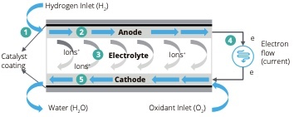
Industry Overview
A fuel cell is an electrochemical reactor that converts the chemical energy of hydrogen and oxygen directly to electricity with its only byproduct being water
Energy efficiency from tank to wheels is 36-45% compared to 65-82% for BEV’s and 17-21% for ICEV’s
Refilling hydrogen is significantly faster than recharging batteries and fuel cells are a lot lighter than lithium-ion batteries typically used in Electric Vehicles (energy to weight ratio ten times greater)
Applications include transportation (EVs, trucks, forklifts, buses) and stationary power (“CHP”, “UPS”)
The average cost for FCEV’s is projected decrease below the prices of BEV’s and ICEV’s
Scale-up of production and distribution of FCEV’s will reduce the cost significantly
If 0.6 million FCEV’s are produced per year, the TCO will fall by 45 percent versus today
Cost of production of low carbon and renewable hydrogen will fall up to 60 percent between 2020 and 2030 (hydrogen will comprise of 90 percent of total decrease of FCEV’s cost)
Hydrogen to play key role against global warming
From 2020 to 2025, could be competitive in transportation, particularly large vehicles
By 2030, even more applications will become cost competitive against low carbon alternatives
By 2050, CO2 emissions will have to be 90 percent lower than they are today
Energy Ministerial Council target to have 10,000,000 FCEV’s and 10,000 hydrogen stations across the globe by 2030
Operating principle of the fuel stack
Operating principle of the fuel stack

Slide 5
Industry Overview
Largest low-carbon hydrogen production policies are on supply and production side
European commission's 40 GW target by 2030, France 6.5 GW by 2030, Germany 5 GW by 2030, UK 5 GW by 2030
Low carbon hydrogen can constitute 7% of final energy demand by 2050
US and China to be largest markets for low carbon hydrogen by 2030
California Fuel Cell Partnership aiming for 1,000 hydrogen stations and 1,000,000 FCEV’s by 2030
European Commission’s “Green Deal” includes climate neutral goal by 2050; European Industry Strategy includes sustainable mobility; Clean Hydrogen Alliance; €750b “Green Recovery” plan announced
EU requirement for 30% emission reduction for Class 8 trucks by 2030; extended to buses in 2022
In March of 2020 Ballard noted in their annual report that the company would continue to execute a strategy targeting three core geographic markets: Europe, China, and California (with expectation to grow and opportunities in other markets as they become attractive)
California appears to be a particularly promising geographic target as governor Gavin Newsom announced in late 2020 that the state will aim to phase out gas powered vehicles
The California Energy Commission has authorization to allocate up to $20 million per year through 2023 and is investing in an initial 100 public stations to support and encourage these zero-emission vehicles
Following the governor's order, the California Air Resources Board said that it will develop regulations to mandate that 100% of in-state sales of new passenger cars and trucks are zero-emission by 2035
Projected Global Electrolysis Capacity (in MW)
CAGR 111.54%
Cumulative total FCEV sales in the US so far
CAGR 90.37%

Slide 6
ESG Analysis
Environmental
Social
Governance
Goal of carbon neutrality by 2030 through the “Mission Carbon Zero” initiative
Greenhouse Gas Emissions
Corporate GHG Inventory is tracked by a third party that measures Ballard’s Scope 1, II, and III emissions
Uses life cycle assessments to quantify GHG emissions throughout a fuel cell’s entire supply chain
Reducing Energy Consumption
42 corporate initiatives for reducing energy use
19% decrease in per-employee electrical consumption in 2019
Recycling and Waste Management
Recycles thousands of fuel cell stacks each year
Non-recycled waste per person dropped by 20% in 2019
Philanthropy
Holds annual fundraisers for the Vancouver chapter of charitable organization United Way
Raised over $99,000 for United Way in 2018, and won the United Way Teamwork Spirit Award for recruiting the most diverse campaign team
Gender Equality
Named in the 2020 Globe & Mail “Women Lead Here” list, which identifies 73 Canadian companies where women are strongly represented in leadership positions
Supply Chain Ethics
Conflict Minerals policy verifies that all smelters and refiners in the supply chain do not utilize raw materials that finance armed conflict
Requires suppliers to comply with a code of conduct that covers labor conditions, freedom of association, anti-corruption, and other potential issues
Whistleblower Policy
Employees can anonymously report unethical or illegal conduct through a third-party online platform
Political Contributions
Does not make financial contributions to political causes

Slide 7
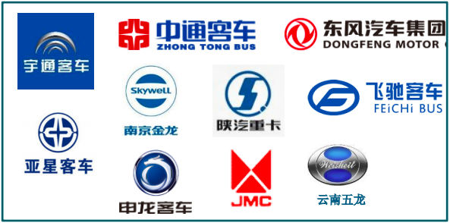
Investment Rationale
Strategic Collaboration with Weichai in China
In November of 2018, Ballard closed a deal with Chinese state-owned company Weichai which included an equity investment from Weichai into Ballard as well as the formation of a joint venture company and a development program
Ballard Q3 2020 operating highlights noted that China’s government would be working toward implementing a new official policy regarding Fuel Cell Electric Vehicles (FCEVs), setting a framework for scaled adoption toward the national goal of deploying 1 million FCEVs by 2030
In August of 2018, Weichai made a $163.6 M equity investment into Ballard (approx. representing a 19.9% interest in Ballard) through its wholly-owned subsidiary Weichai Power Hong Kong International Development Co., Limited
The investment was executed through the purchase of common shares from treasury, at a price of $3.54, which reflected a 15% premium to the 30-day volume weighted average price of $3.08 on August 29, 2018
Weichai and Ballard also formed the Weichai Ballard Joint Venture in Shandong Province to support China’s fuel cell electric vehicle market. Ballard holds a 49% ownership position and Weichai holds a 51% ownership position.
Weichai’s long term clean energy goal for the company is to build and supply at least 2,000 fuel cell modules using Ballard or Weichai-Ballard JV technology by 2021 for commercial vehicles in China
In an effort to support the research and development of new fuel stack technology (Ballard’s next-generation FCgen®-LCS fuel cell stack and FCgen®-LCS-based power modules) which will be used for bus, commercial truck and forklift applications with exclusive rights in China, Weichai-Ballard JV will be manufacturing these technologies
In order to enable these manufacturing activities, the Weichai-Ballard JV will pay Ballard $90 million under the Research and Development Agreement to develop and transfer technology to the Weichai-Ballard JV
Ballard Technology Powering ~45% of all FCEVs in China
17 Original Equipment Manufacturers
3,250 vehicles
42 M km’s
Vehicle OEM’s
System Integrators

Slide 8
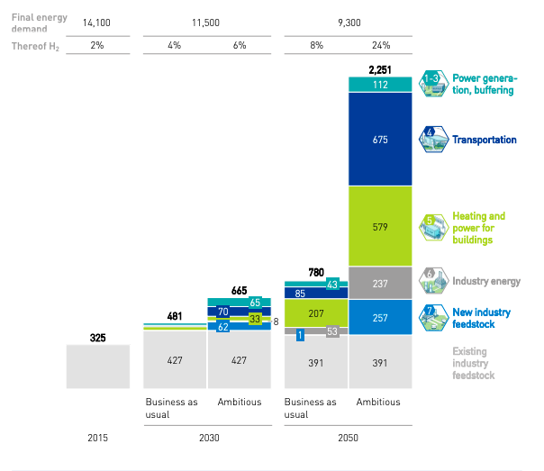
Investment Rationale
European Union Ambitions to Derive a Substantial Share of Energy from Hydrogen
Audi AG extension of their HyMotion program presents an opportunity for Ballard to provide Technology Solutions
In 2018, Ballard and Audi signed a 3.5 year extension to their Technology Solutions contract with Audi AG to extend Audi’s HyMotion program to August 2022 which will aim to support Audi through its small series production launch
The continuation of Ballard’s multi year Development Agreement with Siemens AG secures the development of the Mireo light rail
Ballard has also been involved in a multi year Development Agreement with Siemens AG since 2017 to support the creation and development of a zero-emission fuel cell engine to power Siemens’ Mireo light rail train
In 2019, the agreement had an expected value of $9 M over 3 years and Ballards 2019 annual report announced that initial sales activities for the fuel cell-powered Mireo train are planned for 2021
In December of 2020, Ballard announced that they would be collaborating with a Norwegian power conversion company called Eltek Nordic
The collaboration will allow Ballard to provide Eltek Nordic with a fuel cell backup power system for telecom networks and other critical communication infrastructure for the Norwegian company
Backup Power revenue was reported to make up $1 M and increased by 540% from Q3 2019 as the company experienced an increase in shipments of fuel cell stacks to customers in Europe
BLDP is Best Positioned to Capitalize on EU Hydrogen Energy Ambitions
Hydrogen Could Provide Up to 24% of Total Energy Demand, or Up to ~2,250 TWH of Energy in the EU by 2050, Giving Ballard the Advantage of Satisfying this Demand in Europe

Slide 9
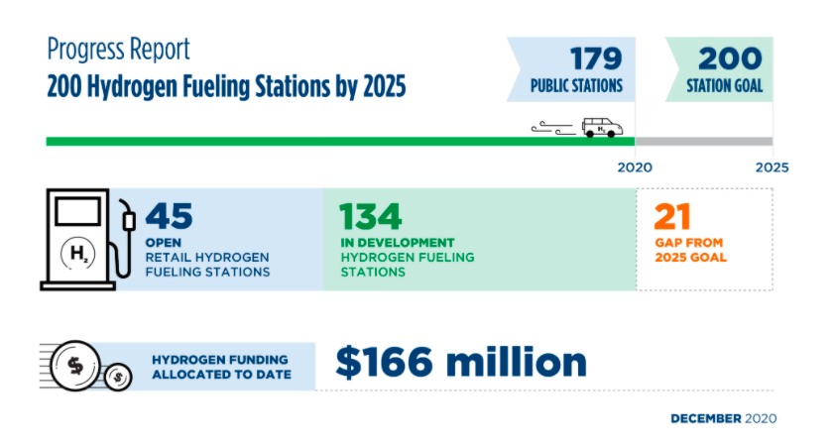
Investment Rationale
Future Expansion in the U.S.
Ballard has a massive opportunity to collaborate with American companies like General Motors, who announced that they will be making the switch to sourcing 100% renewable energy resources to power their plants in the U.S. by 2035
With 300 global companies signing a pledge in early 2021 to reach a net-zero carbon emission target, it will force automobile manufacturers to be the first companies to adopt net-zero carbon emission targets and makes Ballard an incredibly favorable company to collaborate with
Ballard priming themselves as a reputable and efficient provider of hydrogen fuel cell energy accompanied by American automobile manufacturing companies’ willingness to transition to renewable energy sources gives them the opening necessary to expand their position in the United States
In early February 2021, Ballard Signed a joint Development Agreement with Chart Industries for Heavy-Duty Mobility Onboard Hydrogen Solutions
Ballard announced that they had signed a non-binding Memorandum of Understanding with Chart Industries Inc. , a leading global manufacturer of cryogenic equipment used in the production, storage and distribution of liquefied natural gas (LNG) and industrial gases
The agreement between the two companies promises the joint development of integrated system solutions that include a fuel cell engine with onboard liquid hydrogen ("LH2") storage and vaporization for the transportation industry, with a focus on heavy-duty applications including buses, trucks, rail and marine vessels
California Energy Commission Hydrogen Fueling Station Plans
U.S. Fuel Cell Research and Development

Slide 10
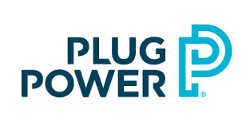
Competitive Landscape
Ticker | NYSE: BE
Market Cap | $6.72B
P/E Ratio | N/A
Beta | 3.71
Ticker | NASDAQ: PLUG
Market Cap | $28.26B
P/E Ratio | N/A
Beta | 1.61
Ticker | NASDAQ: FCEL
Market Cap | $7.13B
P/E Ratio | N/A
Beta | 5.33
Develops, manufactures, and markets solid oxide fuel cells for the healthcare, retail, and education sectors
Has never generated a profit despite at least $1.7 billion of invested capital, some of which were raised on the back of false statements while Ballard’s gross profit of 2020 saw a 13.78% increase year-over year
Shares have plummeted nearly 50% since Bloom raised $282 million in its 2018 IPO
Develops hydrogen fuel cell systems that replace conventional batteries in equipment and vehicles powered by electricity
Ballard has a significantly higher gross margin at 21.8% vs PLUG’s 8.4%
Ballard burns substantially less cash at the rate of $46 million per year compared to $186 million annually for Plug Power
Has estimated earnings of -$0.07 per share for this upcoming quarter, a year-over-year decline of 16.67% while Ballard has no estimated decline in earnings per share
Designs, manufactures, operates, and services Direct Fuel Cell power plants that run on natural gas and biogas
Ballard’s total assets increased at a far greater CAGR over the past three years at 47.5% vs FCEL’s 11.2%
Ballard generates a stronger 12-month revenue at 1.81x what FCEL produces
FCEL has a negative gross margin whereas Ballard’s gross margin at 20.5% will enable the company to have more capital on each dollar of sales

Slide 11
Risk Factors
Ballard Has Not Been Generating Profits or Positive Cash Flow
Ballard has only generated a net profit once in 2015 in the past 10 years meanwhile its revenue has climbed 92.7% during that time period
Mitigant: Analysts expect the company to incur a final loss in 2021, before generating profits of US $4.3 million in 2022
Mitigant: Ballard’s participation in the European Union’s Green Hydrogen Plan will promote the company is the primary source for clean energy and will encourage future business contracts in the EU
Mitigant: Ballard along with the other companies in the union will be able to meet 24% of world energy by 2050, a positive contribution to the world for a greener economy
Trouble Seeding to Technology in Markets Such as Buses, Trains, and Tracks
Ballard order backlog for its heavy-duty motives, a main market of the company, was significantly down compared to previous quarters and was a 10% year-over-year drop at the end of Q1 2019
Mitigant: Ballard has a joint-venture with Weichai Power of China, where the government is targeting 20% of vehicles to be powered with alternative energy by 2025
Mitigant: Ballard has a purchase order from Scotland’s Arcola Energy for its fuel cell modules to power a passenger train
Mitigant: Ballard has received orders for 45 motive modules to power buses in Germany and The Netherlands
Mitigant: California Air Resources is requiring public transit agencies over the next 20 years to transition to 100% zero emission bus fleets, enabling Ballard to offer their services at its fullest capacity
Burning Cash Reserves Causing Investors To Worry
Ballard has been depleting its cash reserves at a faster rate compared to last year’s causing investors to worry about the company’s financial health
Mitigant: Company’s price shares has soared by 239% within a year’s time frame
Mitigant: The company’s cash burn is only about 0.5% of its $10B market capitalization
Sources: Fool, Bloomberg, Reuters, Stock News, NASDAQ, The Street
9

Slide 12
Comparable Companies Analysis

Slide 13
Discounted Cash Flow

Slide 14
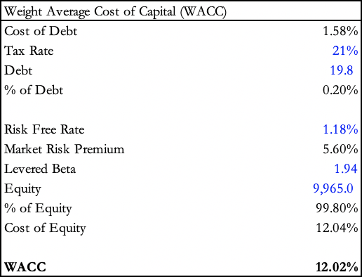
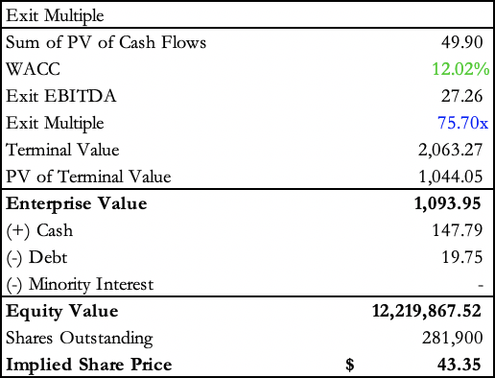
DCF Output

Slide 15
Q&A

