Slide 1
Current: $40.02 Target Price $48.55 (+21%) Time Horizon: 18-24 months
Brookfield Renewable
Partners L.P. (NYSE: BEP)
Directors: Sarah Ziegler
Analysts: Carl Aller, Shaun Ge, Christian Geheres, Helena Macrigiane, Matthew Szell

Slide 2
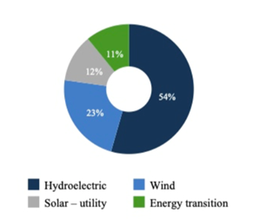
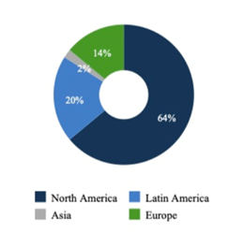
Company Overview
Business Description
Brookfield Renewable Partners is a globally diversified, multi-technology, owner and operator of renewable power assets.
Its portfolio consists of 19,000 MW of capacity and annualized long-term average generation of approximately 56,300 GWh.
Brookfield Renewable Partners has a large pipeline of projects across hydro, solar, and wind.
Provide primary and backup power for commercial, industrial, and residential buildings
Brookfield Renewable has a 20-year track record as a publicly traded company and has nearly $60 billion in assets. Brookfield Renewable aims to continue growing distributions by 5-9% annually and delivering 12-15% to shareholders over the long term.
Source of Energy
Region
Notes:
Brookfield Renewable is a master limited partnership (MLP) that makes money by selling the energy produced by its portfolio of renewable assets -- mostly hydropower, but also a growing collection of solar and wind farms. Ninety-five percent of Brookfield's generation is secured by fixed contracts, many of them long term.

Slide 3
Financial Overview
52-Week Price Chart
Funds from Operations (FFO) Growth
81%
71%
40.02
Enterprise Value Walkthrough
Key Financials
$ in USD, Millions (aside from share price)
Share Price | $40.02
Shares Outstanding | 274.84
Equity Value | $10,999
Cash & Short Term Investments | $493.0
Total Debt | $18,079
Enterprise Value | $28,585
Market Cap | $10.99B
52 week Beta | .98
Forward P/E | N/A
EBITDA (FY20) | $2.2B
EPS (FY20) | -$0.67
Gross Margin (FY20) | 29.4%

Slide 4
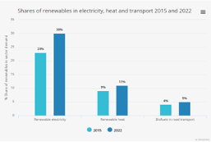
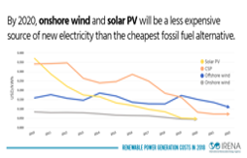
Industry Overview
Renewables (especially wind and solar) are the fastest-growing energy infrastructure category in the world
Renewable energy outpacing conventional power in investments
Renewable power assets generate stable cash flows
Renewables have no fuel costs and relatively low operating costs
Renewable Energy is on the Rise
Total installed wind and solar PV on course to surpass natural gas & coal
Total power investment CAGR to increase by 2030
Annual energy consumption from renewable energy sources has exceeded coal consumption.
The average cost for Renewable Energy is cheaper than Fossil Fuels.
Cost of generating electricity from wind and solar has declined
Power system costs can be cut by replacing coal with alternatives.
Price of electricity from solar declined by 89% in past 10 years
Demand for Renewable Energy
Cost Efficiency of Renewable Energy

Slide 5
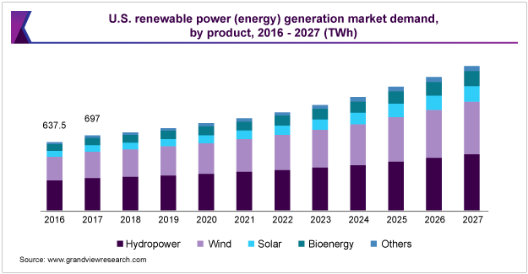
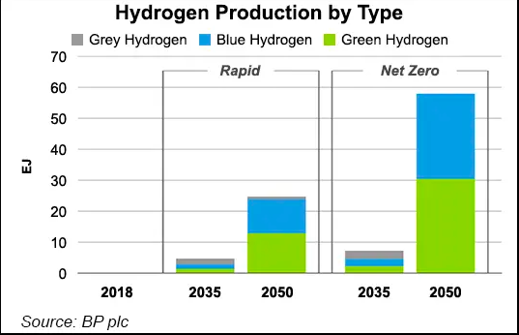
Industry Overview
Brookfield Renewable Energy Partners acquires TerraForm companies for $1.4 billion in 2017
Over 5,000-megawatt portfolio of operating wind and solar assets added to Brookfield’s platform
Access to large-scale capital and the ability to manage and efficiently operate a diverse, global fleet
Establishing operating platforms in new high-growth markets such as India and China
Emergence of Green Hydrogen
Brookfield supporting the development of emerging emissions-free fuel sources
Plant will utilize 100% renewable energy from Brookfield Renewable’s Holtwood hydroelectric facility
Energy Market Demand
Hydrogen Production Industry Breakdown

Slide 6
ESG Analysis
Environmental
Social
Governance
Sustainability is at the core
Greenhouse Gas Emissions
Brookfield's portfolio of power generation helped to avoid approximately 26 million tons of CO2 emissions (“t CO2 e”) on a net basis in 2020. Making them very strongly carbon negative
Philanthropy
Enhancing Community Relations
Occupational Health and Safety
Diversity and Inclusion
Global Diversity Advisory Policy
Formed to extend BEPs efforts to increase diversity by broadening focus beyond gender. The mandate of the group is twofold: provide insight into the concerns, challenges and successes around attracting and retaining members of the Black community and other underrepresented groups within our asset management business; and to find ways to increase our engagement with these groups
Commitment to Human Rights
Environmental Management system
Asset management policy
ESG due diligence guide
Dam safety policy

Slide 7
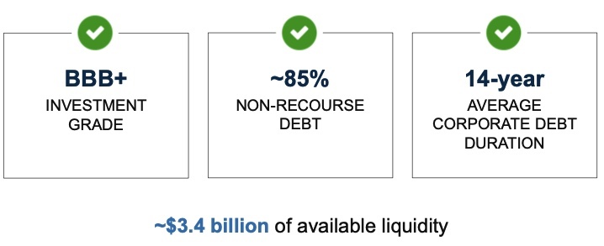
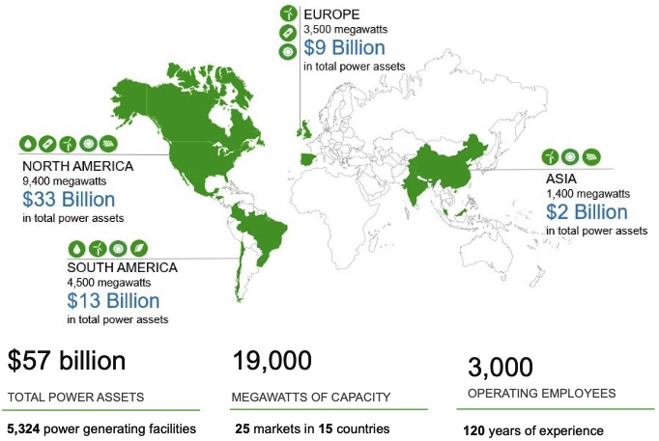
Investment Rationale
Primary business objective is to generate growing and stable cash flow while minimizing risk
Brookfield has a very strong balance sheet and liquidity
Brookfield’s raises most of its debt (82% of total debt) in the form of asset specific, non-recourse borrowings
Management expects no issues addressing total debt through 2025 equaling $8.6 billion from 2021 to 2025
$3.3 billion in available liquidity in 2020, up from $2.7 billion in 2019, sufficient to fund growth initiatives, acquisitions, distributions and adverse changes or short-term fluctuations
Extended average duration of corporate debt from 10 to 14 years through the issuance of C$775 million of corporate green bonds
Resilient cash flows and operations
Brookfield reported funds from operations (FFO) of $807 million or 1.32 on a per unit basis in 2020, respectively a 6% and 2% increase from 2019
Brookfield extended their contract profile by signing over 200 contracts in 2020 to deliver more than 3,500 GWh of clean energy annually (equivalent carbon avoidance of planting 30 million trees); and
Supply Plug Power’s production of 10 tons of 100% green liquid hydrogen per day and over 90% of JPMorgan’s real estate operations in New York State
Brookfield Renewable by the numbers
Brookfield’s primary geographic markets

Slide 8
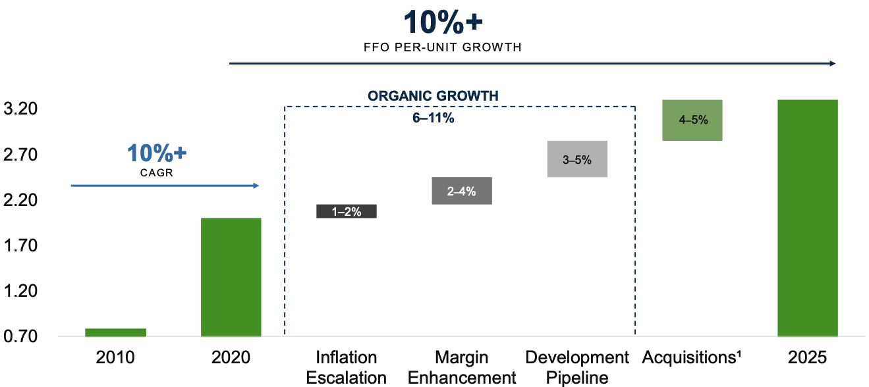
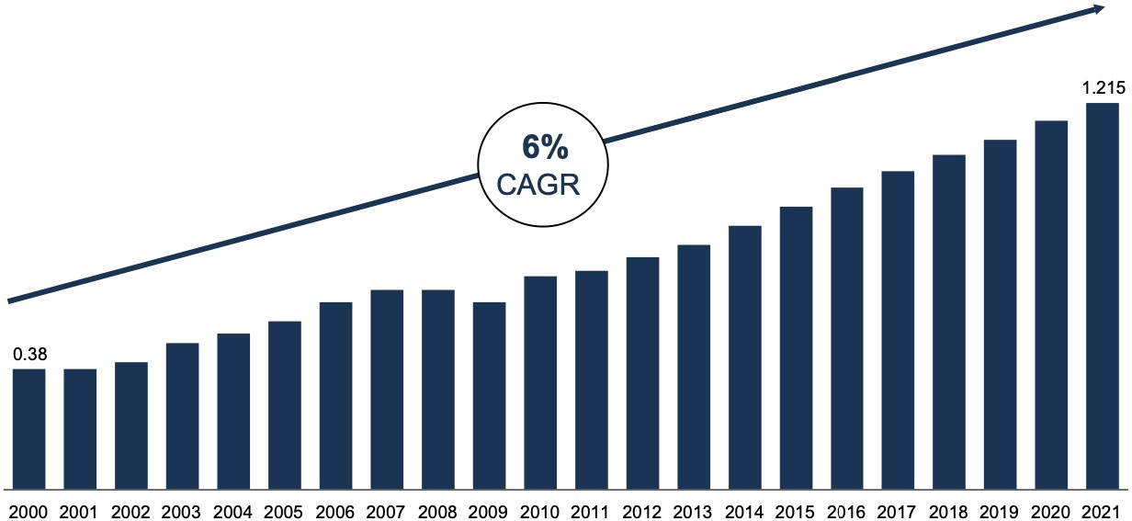
Investment Rationale
Development Pipeline & Acquisitions
In 2020 alone, Brookfield renewable invested nearly $4.6 billion of equity across various transactions
Exelon Generation Company’s US distributed generation business, comprising of 360 MW of operating generation
Brookfield acquired the Shepherds Flat wind farm, which consists of an 845-MW wind generation facility
Represents one of the largest onshore wind projects in US
In December, Brookfield acquired a 270-MW late-stage development wind project in Brazil
Target markets outlining new policies to address climate change
Increase of the social cost of carbon in US to $50 per ton
Carbon tax in Canada set at $30 per ton and set to increase 6-fold to $170 in 2030
European Green Deal for the European Union (EU)
China's president Xi Jinping announced in front of UN General Assembly that they aim to have CO2 emissions peak before 2030
Great visibility on cash flow growth
Distributions on a per unit basis since inception

Slide 9
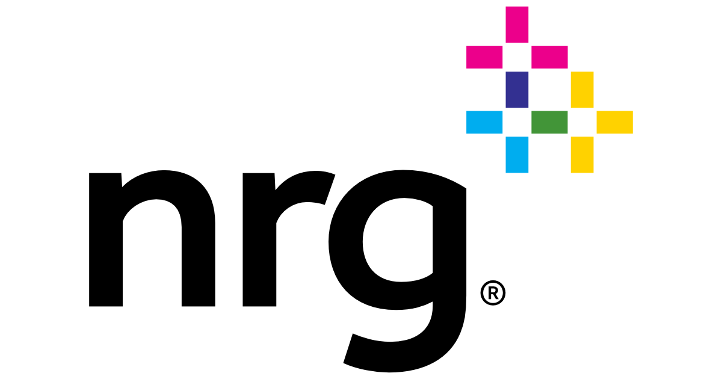
Competitive Landscape
Ticker | NYSE: AES
Market Cap | $18.56B
P/E Ratio | 364.9
Beta | 0.80
Ticker | NYSE: NRG
Market Cap | $9.476B
P/E Ratio | 18.1
Beta | 0.85
Ticker | NYSE: TAC
Market Cap | $3.32B
P/E Ratio | N/A
Beta | 1.37
Utilities: Natural gas, coal, pet coke, diesel, oil, hydro, solar, wind, energy storage, biomass, and landfill gas
Generative Power: 30,308 MW It has operations in the United States and internationally
Incorporated 1981, headquartered in Arlington, Virginia
Currently holds $18.8 B in debt and has for almost 10 years with little to no reduction. Given that it is currently shifting focus towards its renewable system operations given market focus, this could negatively impact their cash flow which manages their debt.
Operational Consumer Count: 3.6 million residential, industrial, and commercial sectors
Electricity Production Segments: Natural gas, coal, oil, solar, nuclear, and battery storage
Generative Power: 23,000 MW of capacity at 33 plants
NRG Energy Inc. expects to record a $750 million loss because of the cold snap in Texas and resulted in sweeping blackouts. NRG CEO commented that the company is still unable to provide financial guidance due to the "unprecedented" nature of the event.
Operational Geography: Canada, the United States, and Australia
Energy Segments: Hydro, Wind and Solar, North American Gas, Australian Gas, Alberta Thermal, and Centralia
Founded 1909, headquartered in Calgary, Canada
Coal and natural gas extraditing exposes TransAlta to greater cost risks and overextends their business model in terms of limiting externalities and asset management.
Notes:
TRANSALTA
What is Alberta Thermal and Centralia?
Alberta Thermal = Coal Power Plant
Centralia = Coal Power Plant
NRG
Retail Customer Brands: NRG, Reliant, Green Mountain Energy, Stream, XOOM Energy
Why do they operate under so many brand names? --> They acquired them

Slide 10
Risk Factors
Supply and demand in the energy market can be volatile and can adversely affect electricity prices: The energy industry faces rapid change. Advances in technology endanger assets
Brookfield is paying $810 million for the acquisition of a scale distributed generation platform in an agreement with Exelon Generation Company
Approximately 84% of 2021 generation (2019: 95% of 2020 generation) is contracted under short-term and long-term power purchase agreements and financial contracts
The interest on 90% of the contracts are at a fixed rate, usually around a 4% profit margin
Reduce country-specific risks through diversification of acquisitions
Dependence on counterparties to company’s contracts
PPA purchasers may be unable/unwilling to fulfill contractual obligations or refuse power delivery
Diverse counterparty base with long-standing credit histories
Exposure to counterparties with investment-grade credit ratings
Sources: Fool, Bloomberg, Reuters, Stock News, NASDAQ, The Street
9
Notes:
1.1 -- INCREASING TOTAL PORTFOLIO TO APPROXIMATELY 2,000 MEGAWATTS OF OPERATING AND UNDER DEVELOPMENT DISTRIBUTED GENERATION IN THE U.S. -- This is a mitigant because by increasing their total power output they reduce their risk to price fluctuations
1.2 -- These long-term contracts specify the price at which electricity is sold and again mitigates their risk to short term price fluctuations and provides stable and reliable cash flows
2.1 -- Brookfield could be affected, and may not be able to replace the agreement equivalent terms – Selling to creditworthy parties mitigates this fear and lowers borrowing costs

Slide 11
Comparable Companies Analysis

Slide 12
Discounted Cash Flow

Slide 13
DCF Output

Slide 14
Q&A

