Slide 1

Current Price: $398.18
Target Price: $530.24 (33% Upside)
Time Horizon: 12-24 months
Technology Vertical
Director: Duncan Webber
Analysts: Samantha Marsala, James Lee, Andrew Kanellis, Jordan van der Meulen, & Sarah Gillolly

Slide 2
I. Executive Summary
II. Industry Overview
III. Investment Rational
IV. Perspectives on Valuation

Slide 3






ADOBE Overview
Executive Summary
Overview
Popular Adobe Apps
Headquarters: San Jose, CA
Founded: 1982
Employees: 22,516
Description: Adobe Inc. is a global computer software company that has offices all over North America, South America, Asia, Europe, Africa, and Australia. Adobe specializes in a large variety of software inquiries ranging from graphics, photography, illustration, animation, video, motion pictures and print. It also holds a large amount of space in the digital marketing software industry.
Revenue Highlights
Achieved record revenue of $4.26 billion in the first fiscal quarter of 2022 , which represents 9% percent year-over-year growth
Company Highlights
In March, moved to a new stage of their partnership with Walgreens Boots Alliance to boost engagement and sales
Creative ARR grew to $10.54 billion and Document Cloud ARR grew to $2.03 billion
Acquired multiple companies over the past year including Fame.io, ContentCal, and Abstract Notebooks.
Digital Media Annualized Recurring Revenue increased $418 million quarter over quarter to $12.57 billion exiting the quarter
In May, Adobe and Meta partnered to provide small businesses with essential creative and marketing skills via a new online training program
Sources: Capital IQ, Yahoo Finance, Company Filings & Websites

Slide 4

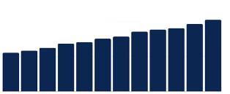
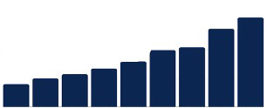
Revenue Streams
Executive Summary
1
Digital Media Revenues
The Digital Media segment offers creative cloud services, which allow members to download and install the latest versions of products, such as Adobe Photoshop, Adobe Illustrator, Adobe Premiere Pro, Adobe Photoshop Light room and Adobe InDesign, as well as utilize other tools, such as Adobe Acrobat
2
Digital Experience Revenues
The Digital Experience segment provides solutions, including analytics, social marketing, targeting, media optimization, digital experience management, and cross-channel campaign management, as well as premium video delivery and monetization
3
Publishing and Advertising Revenues
The Publishing segment includes legacy products and services for eLearning solutions, technical document publishing, web application development, and high-end printing
Digital Media Business Momentum
Digital Experience Business Momentum
Total Digital Media APR
Annual Revenue
10B
~$9.8B
~$10.2B
3B
~$3.2B
~$8.5B
~$8.8B
~$9.0B
~$2.7B
~$6.8B
~$7.0B
~$7.5B
~$7.8B
~$2.2B
~$5.5B
~$5.9B
~$6.3B
2B
~$2.0B
5B
~$1.4B
~$1.6B
1B
~$1.0B
~$1.2B
~$0.7B
0B
0B
Q1FY18
Q2FY18
Q3FY18
Q4FY18
Q1FY19
Q2FY19
Q3FY19
Q4FY19
Q1FY20
Q2FY20
Q3FY20
Q4FY20
FY2012
FY2013
FY2014
FY2015
FY2016
FY2017
FY2018
FY2019
FY2020
Sources: Capital IQ, Yahoo Finance, Company Filings & Websites

Slide 5
I. Executive Summary
II. Industry Overview
III. Investment Rational
IV. Perspectives on Valuation

Slide 6
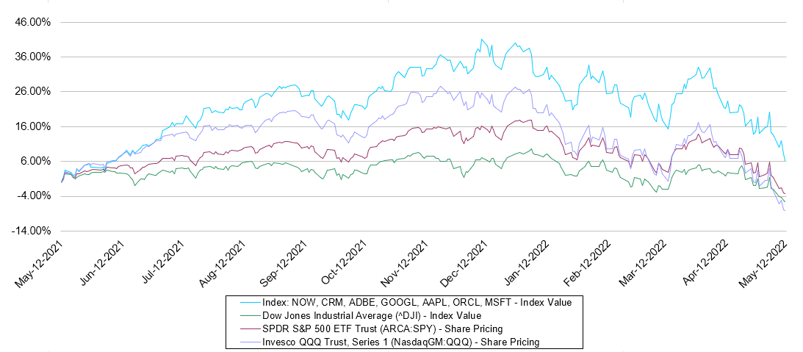






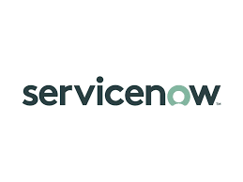

Market Trends: Indices
Industry Overview
  Software & Cloud Index VS S&P500 VS DIA VS Nasdaq
In March, we saw 27.34% Growth in Software and Cloud Y/Y Share Price Performance. As we can see, the Software and Cloud index has
consistently outperformed the S&P, NASDAQ, DIA over this period by 19.87%. As of the current market dip, software continues to pace ahead of the other groups with a 4.58% Y/Y growth, while the others fall into the negatives.

Slide 7
Total addressable market
Industry Overview
Large and Growing TAM
2024 Experience Cloud TAM
~110B
~33B Data Insights & Audiences
~49B Content & Commerce
~18B Customer Journeys
~10B Marketing Workflow
2024 Creative Cloud TAM
~63B
~25B Creative Professionals
~31B Communicators
~7B Consumers
2024 Document Cloud TAM ~32B
~10B Knowledge Workers
~8B communicators
~14B Document Services & APIs

Slide 8
Revenue by geography
Industry Overview

Slide 9
Competitive landscape: software and cloud
Industry Overview
Company
Headquarters
Founded
Market Cap (MM)
Company Description
Alphabet’s Google Workspace includes cloud-based collaboration tools for enterprises, such as Gmail, Docs, Drive, Calendar and Meet; and other services for customers
Mountain View, CA
1998
$1,842,066.63
Microsoft’s develops and licenses software, services, devices, and solutions. It’s OneDrive, Azure, and Office 365 offer cloud-based and on-premises business solutions for organizations.
Redmond, WA
1975
$2,311,358.89
Dropbox provides a content collaboration platform, which allows individuals, teams, and professional organizations to collaborate virtually.
San Francisco, CA
2007
$8,873.48
Apple develops hardware technologies and accessories, along with cloud services such as iCloud, which enables users with cloud storage.
Cupertino, CA
1977
$2,849,537.59
Oracle offers cloud software, such as Oracle Fusion, which enables resource planning, performance management, and other consulting services.
Austin, TX
1977
$220,736.63
ServiceNow provides enterprise cloud computing solutions that defines, structures, consolidates, manages, and automates services for enterprises.
Santa Clara, CA
2004
$111,378.00
Salesforce.com empowers customers to work together to deliver connected experiences for their customers. Its services include Sales, Service, Marketing, Tableau, and MuleSoft.
San Francisco, CA
1999
$210,196.80

Slide 10
I. Executive Summary
II. Industry Overview
III. Investment Rational
IV. Perspectives on Valuation

Slide 11
Catalysts/Risks
Catalysts
Risks
Robust Revenue Growth
Record revenue of $4.26B in Quarter 1 of 2022
Represents a 9% year over year growth
Strong demand across the digital media industry during Covid-19 as well as company growth in software-based subscription revenue
Covid-19
Business turned to subscription-based business model where customer retention rate is essential
Closures of offices/need to spend more money on health and safety protocols
High standards in software delivery, especially with many businesses turning to online platforms
Strong Core Businesses
Implementation of Creative Cloud, Document Cloud, Total Digital Media sectors
Stable growth as a result: Creative Cloud: 7%, Digital Media: 9%, Document Cloud: 17%
Hardware Platform
Harder to adapt products to tablet and mobile devices
Security breaches
Adobe Sign: Implementation will take extensive time and trainings and license fees
Valuation
Stock price recently fell dramatically
Possibility of the stock dropping further during current recession
Relatively high budget where aimless spending may take place
Sustainability Efforts
100% renewable energy goal by 2035
Have reduced environmental impact of products and waste by over 95%
Greater than 70% of employees work in LEED certified offices

Slide 12
Investment Rational
Organic and Acquisition Driven Growth
Rational
Analyst Recommendations
Adobe’s revenue for 1Q22 was 4.26 billion, representing a 9% increase over its revenue in the same quarter last year
Adobe’s strongest business segment, digital media has seen 19% growth YOY. They continue to implement strategies that will accelerate awareness, consideration, and purchase of subscriptions to their Creative Cloud offerings. These strategies include increasing the value Creative Cloud users receive, such as offering new desktop and mobile applications (the Adobe Scan app has seen over 110 million mobile downloads), as well as targeted promotions and offers that attract past customers and potential users to experience and ultimately subscribe to Creative Cloud.
Acquisition of Frame.io and Other Brands: Adobe’s acquisition of Frame.io in October brings Adobe Creative Cloud’s collaboration services to video and builds on recent innovations for creative collaboration including Adobe Creative Cloud Libraries, Cloud Documents, Design Systems in Adobe XD, Adobe Stock, and Adobe Fonts, all of which together with Frame.io, will make it easy for teams to collaborate across Adobe

Slide 13
ESG Analysis
Environmental
Social
Governance
GHG Emissions
Short-term: commits to reduce absolute scope 1 and 2 GHG emissions by 35% by 2025 from a 2018 base year
Long-term: aims to be operating with 100% renewable energy by 2035
Participant of Science-based Targets’ Business Ambition for 1.5°C
Emissions verified by third parties
22 LEED-certified offices
Actively work with non-profits and NGOs like Ceres and Rocky Mountain Institute to affect climate policy
Equality
Committed to supporting gender equality through policy development, representation, and transparency; part of Bloomberg Gender Equality Index 2021
Named in the Working Mother 100 Best Companies 2020 for being a Mother Friendly Employer
Recognized as one of 100 best companies to work for by Fortune
Received 100% on Corporate Equality Index that assesses workplace LGBT equality
Community
Matches employee donations up to $10,000 per year
Awarded $4M to 200 non-profits in 2019
Offers multiple initiatives, scholarship, and fellowships to support underrepresented groups in STEM fields
Structure
Sustainability issues overseen by the Governance and Sustainability Committees
Four executive team members oversee climate related issues and work with the Sustainability Committee
Provides monetary incentives to key managers responsible for implementing sustainability policies
Supply Chain Management
Requires suppliers to follow the company’s Business Partner Code of Conduct and relevant anti-corruption and human trafficking policies
Works with businesses majority-owned and operated by women, minorities, veterans, members of the LGBTQ community, and people with disabilities through the Supplier Diversity Program

Slide 14
I. Executive Summary
II. Industry Overview
III. Investment Rational
IV. Perspectives on Valuation

Slide 15
COMPARABLE COMPANY ANALYS

Slide 16
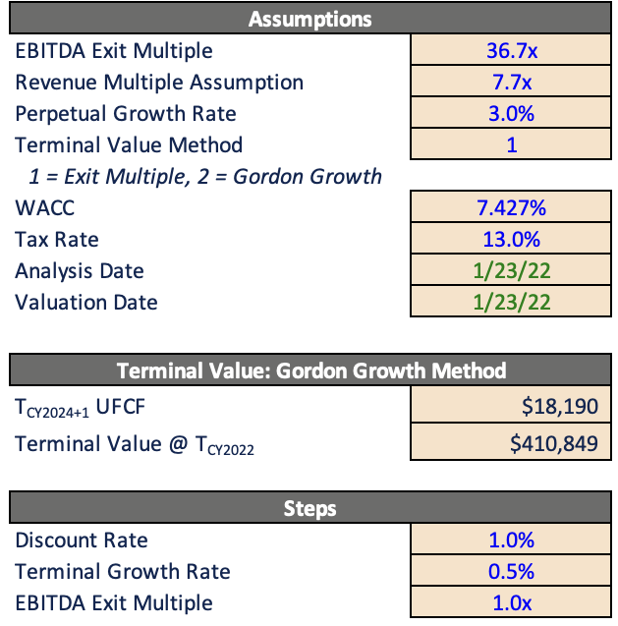
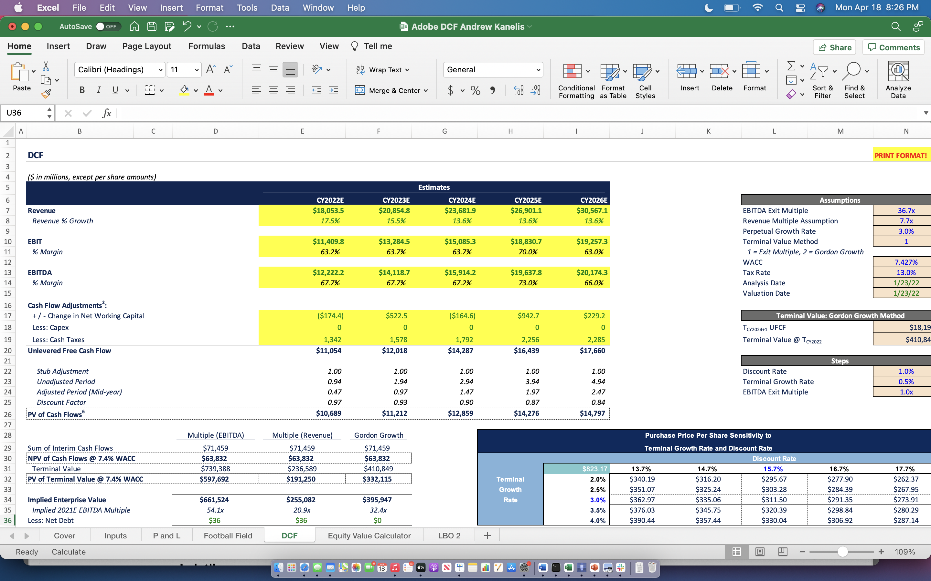
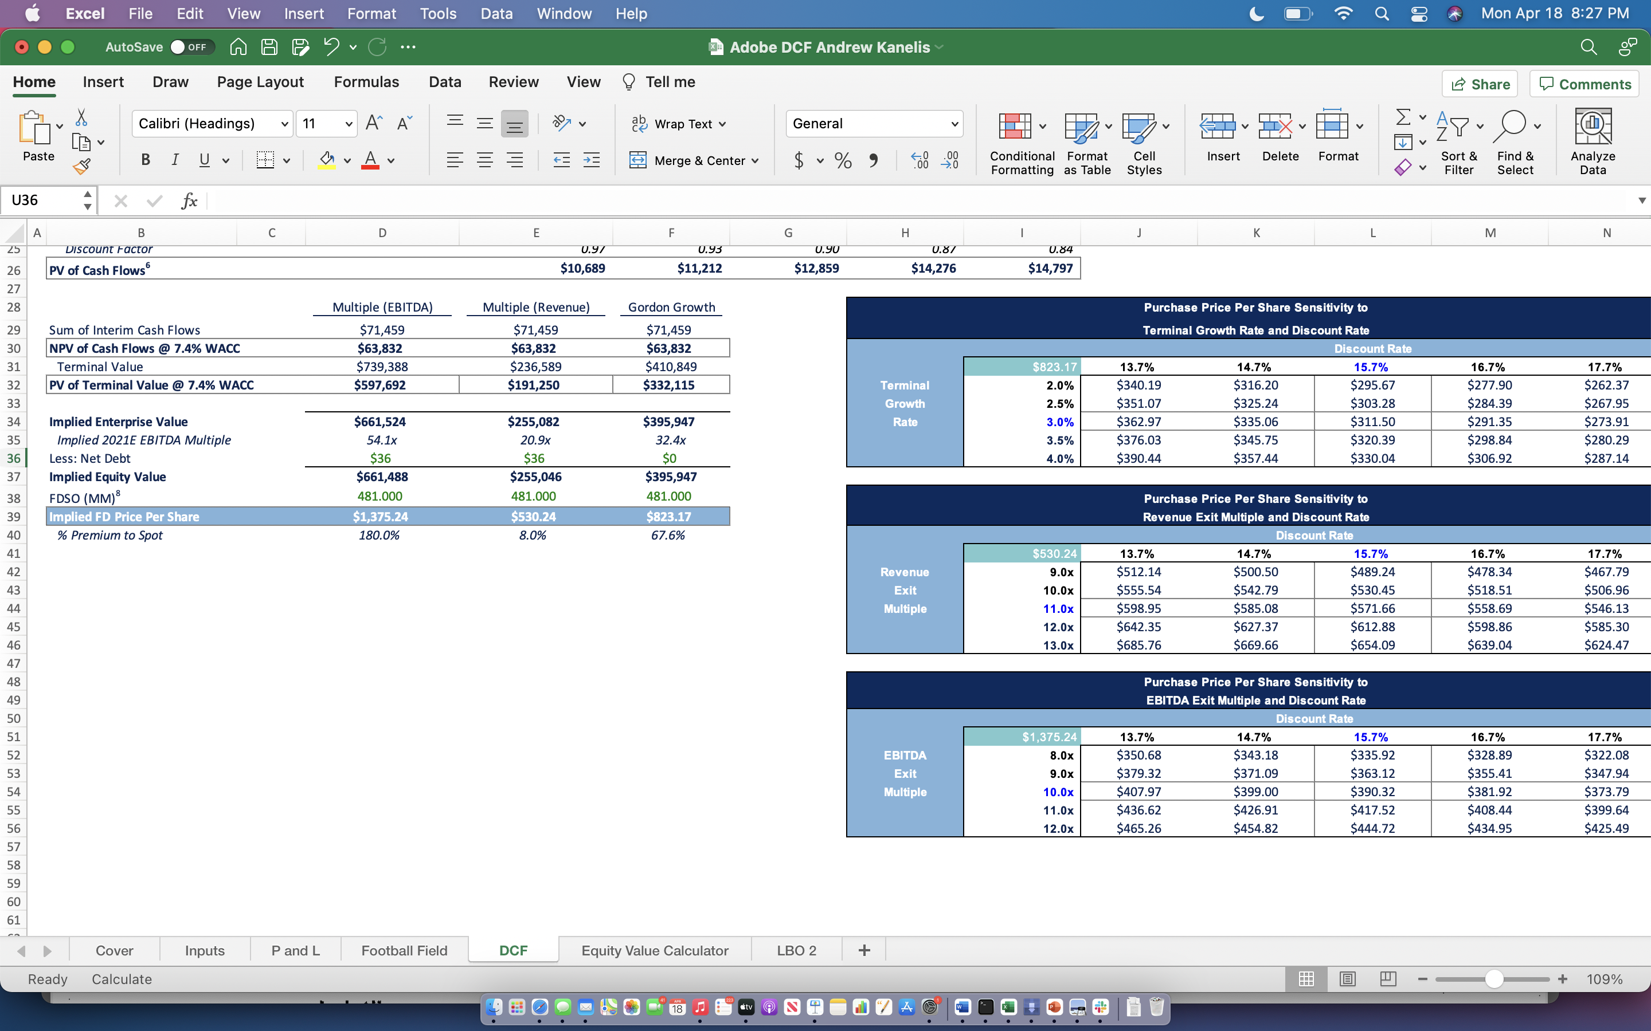
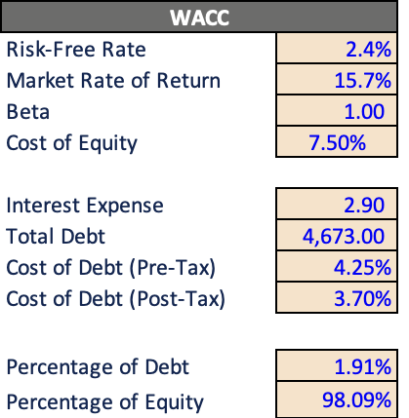
Discounted Cash Flow
Assumptions
Calculations

Slide 17
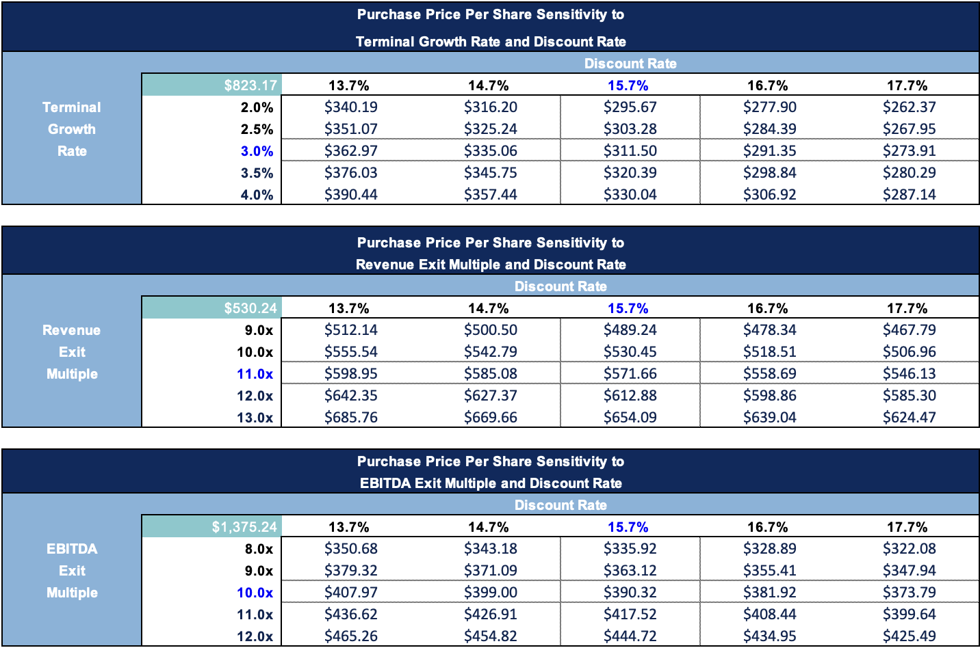
Discounted Cash Flow
Sensitivity Analysis

