Slide 1
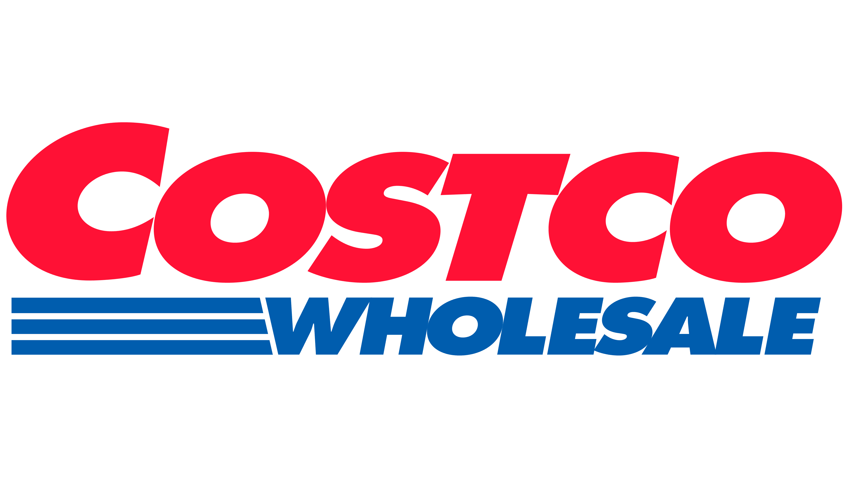

Director: Sameer Mustafa
Analysts: Jarid Haslinger, Patrick Looby, Jordan van der Meulen

Slide 2
I. Executive Summary
Industry Overview
Financial Overview
IV. Environmental, Social & Governance Analysis
V. Competitive Landscape
VI. Catalysts and risks
VII. Investment Rationale
VIII. Comps and DCF Models (Financial Models)

Slide 3
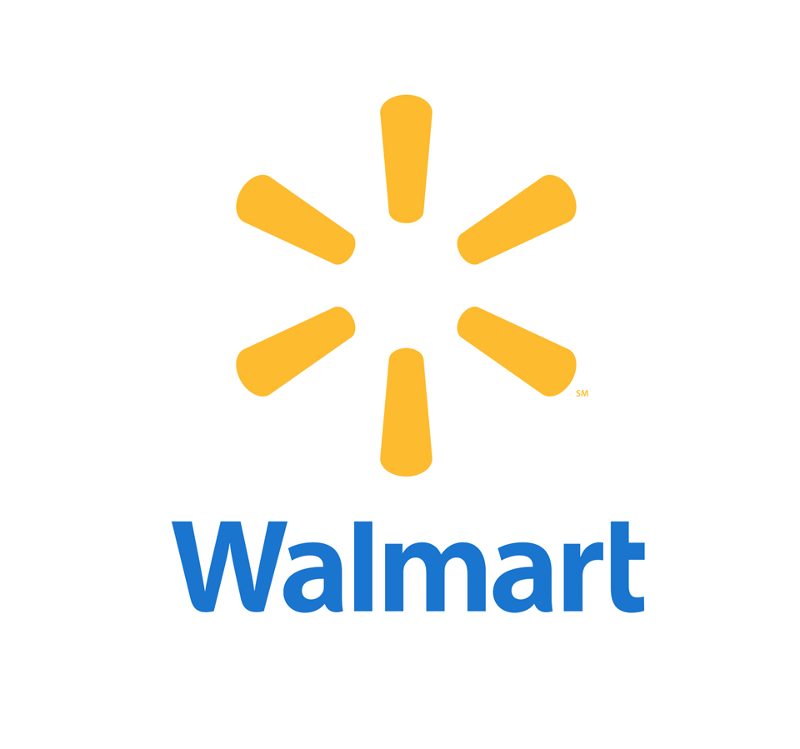


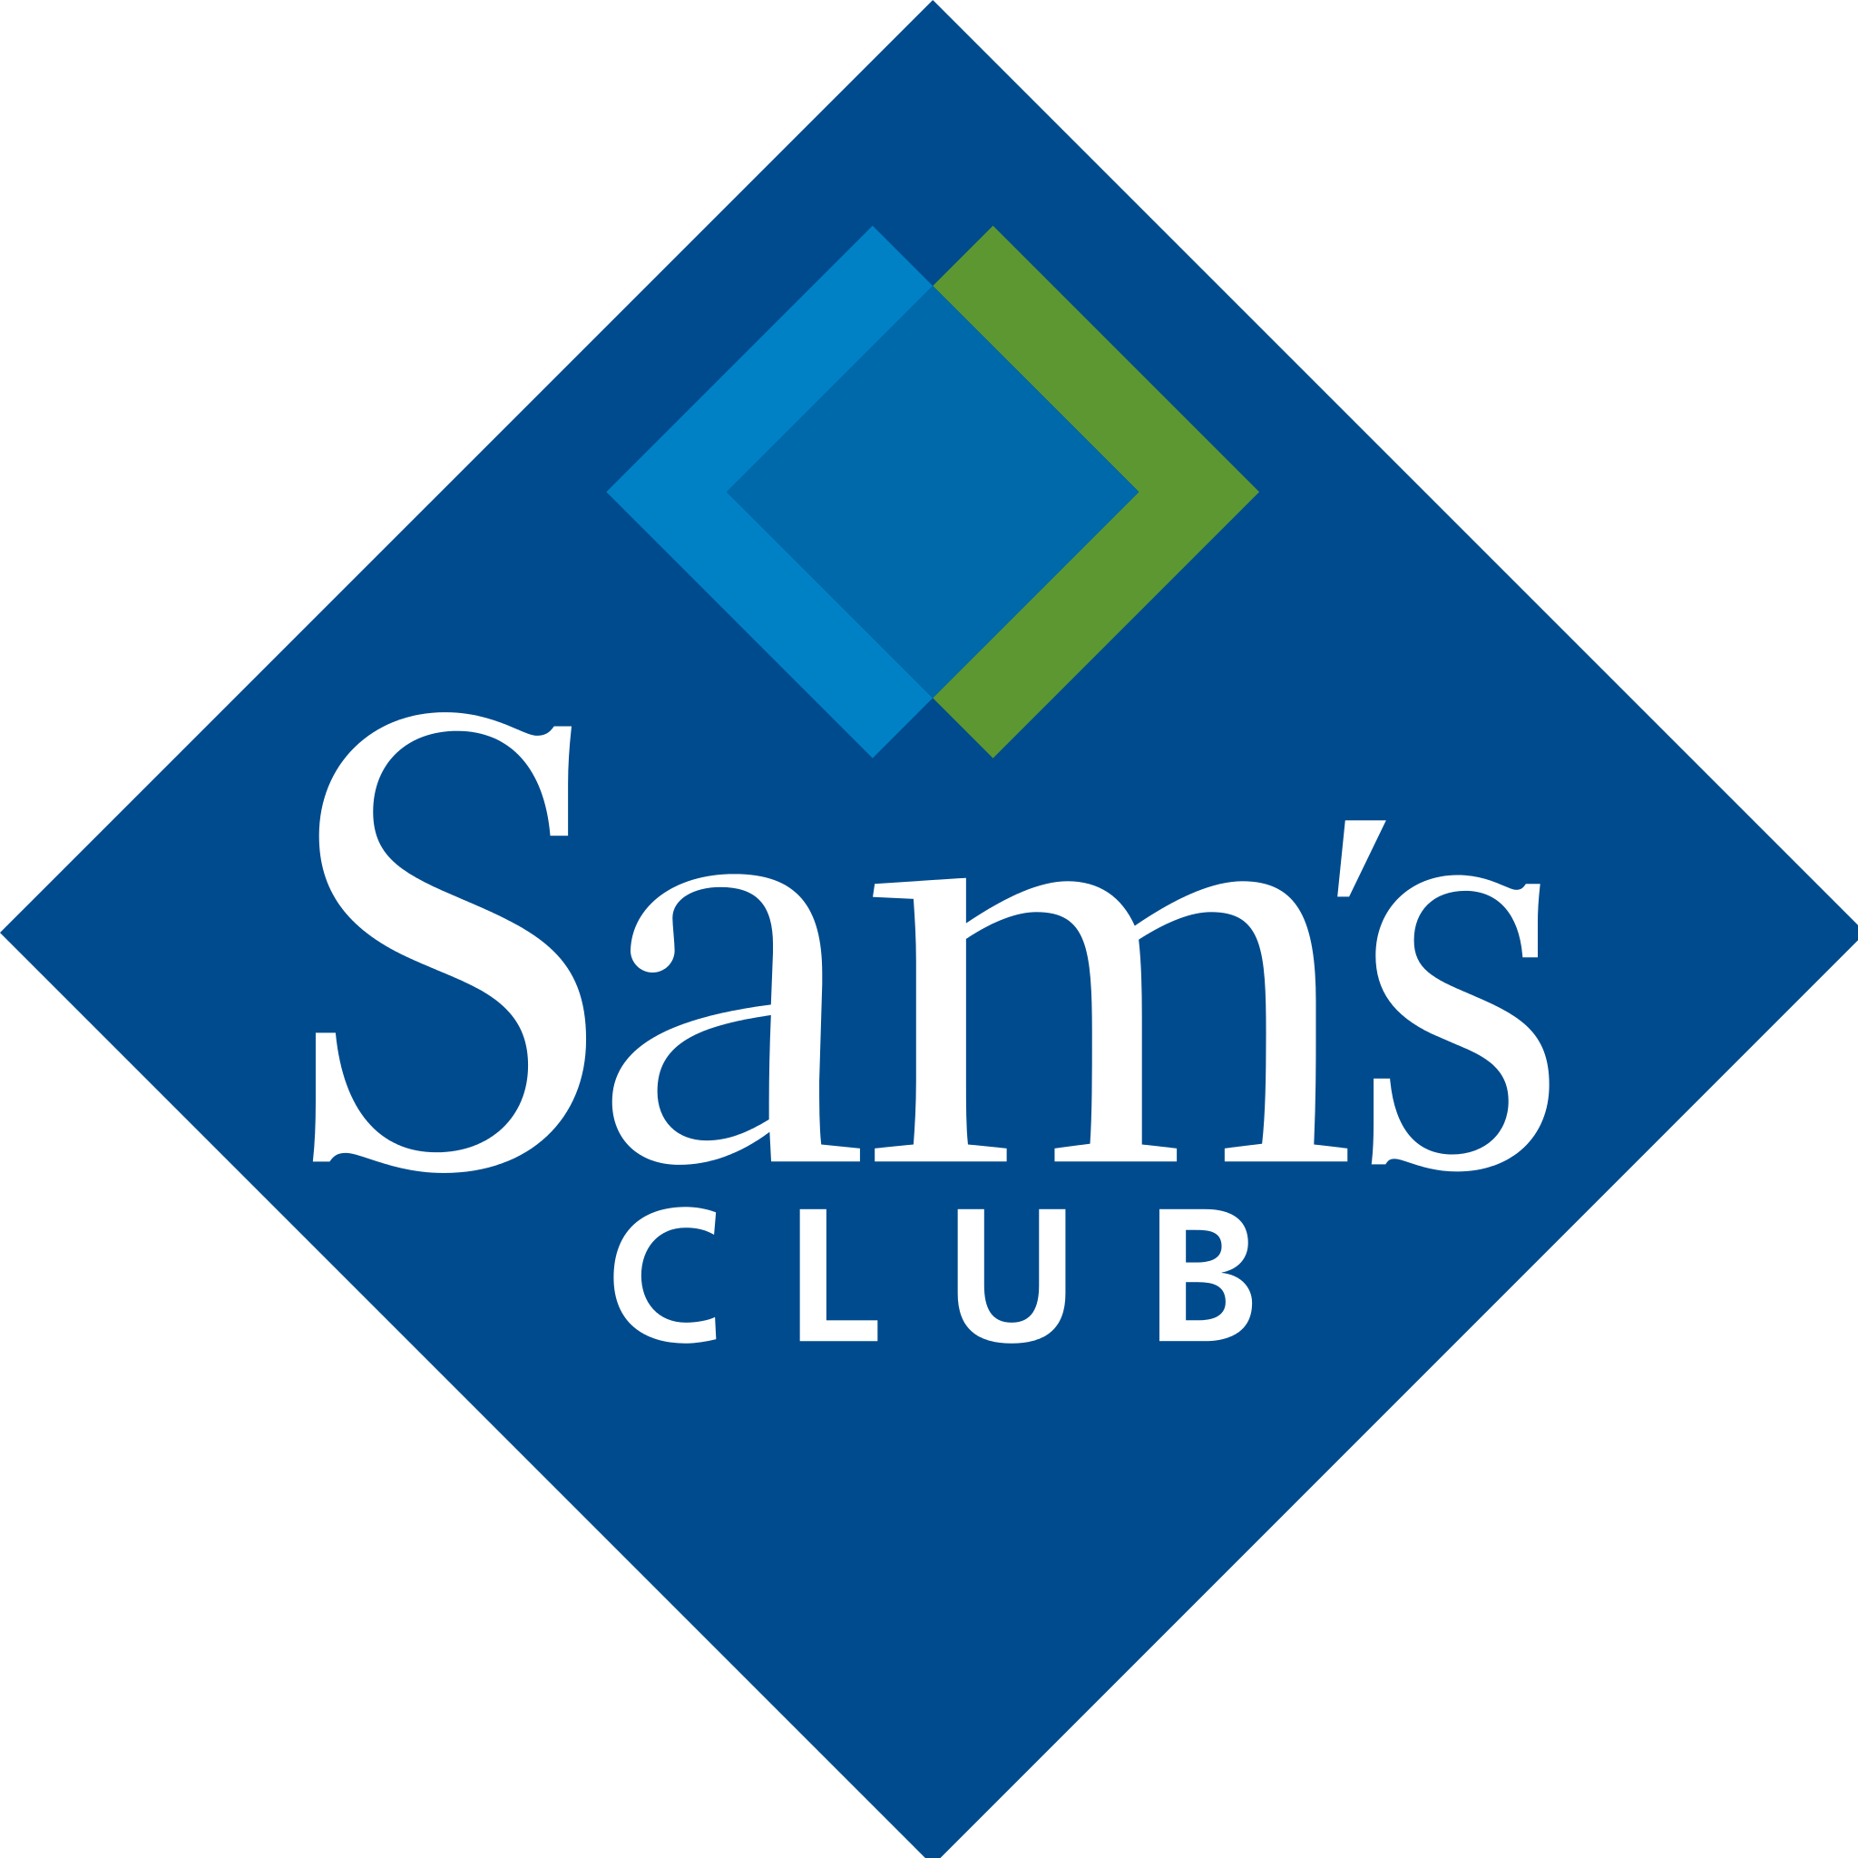

COSTCO OVERVIEW
Executive Summary
Overview
Costco is a Washington corporation with about 304,000 employees and was founded on the 12th of July 1976.
It is publicly traded under the Nasdaq ticker symbol "COST", with its home office in Issaquah, Washington.
Costco sells substantially lower-priced goods than traditional wholesale sources thus making the goal of Costco to help small- to medium-sized enterprises cut expenses when acquiring goods for resale and general office usage.
Individuals can purchase things for their own needs as well.
Costco offers three different membership levels: Executive, Business, and Gold Star, and is exclusively accessible to members.
Key acquisitions
More on Innovel
Innovel Solutions, a national logistics firm, was purchased by Costco Wholesale Corp. for $1 billion
Strengthened the retailer's e-commerce delivery capabilities as the demand for those services rises
Innovel is involved in retail supply chain management, warehousing, last-mile delivery, installation, and other services
The U.S. military, big merchants, and manufacturers are just a few of the diverse industries it serves as clients.
Innovel was owned by Sears parent company Transform Holdco
Competitors
Sources: Statistica

Slide 4
I. Executive Summary
Industry Overview
Financial Overview
IV. Environmental, Social & Governance Analysis
V. Competitive Landscape
VI. Catalysts and risks
VII. Investment Rationale
VIII. Comps and DCF Models (Financial Models)

Slide 5
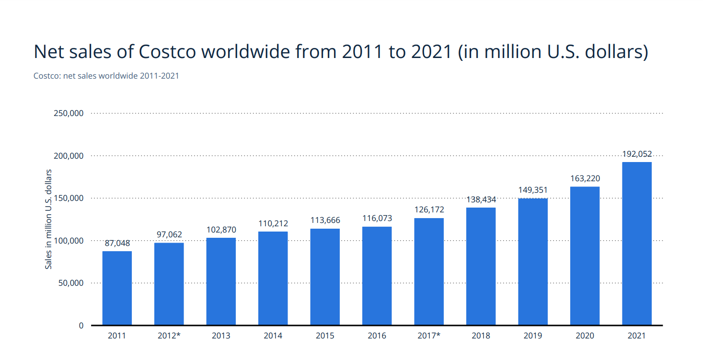
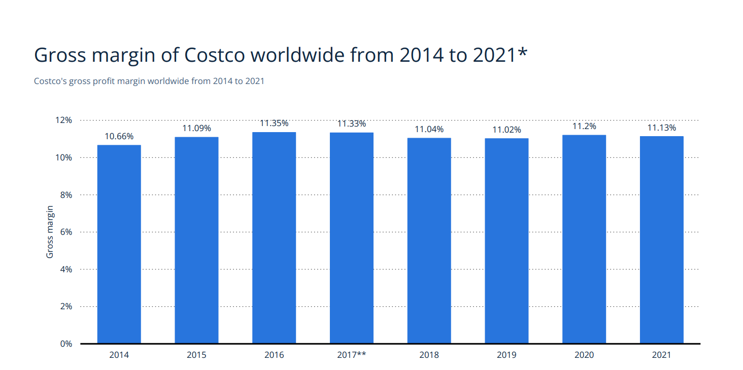
MARKET TRENDS
Industry Overview
Positioned for growth looking forward
Net Sales yearly increase
Net Sales of Costco Worldwide
Key Indicators for a growing market
Y/Y Growth in net sales ($ in millions)
Costco has seen a yearly increase in its global net sales, rising from 110.2 billion U.S. dollars in 2014 to 192.1 billion U.S. dollars by 2021
Costco has made a name for itself worldwide as a members-only wholesale retailer with warehouse style stores
Costco's gross profit margin worldwide has remained relatively unchanged from 2014 to 2021. Costco's worldwide gross profit margin amounted to 11.1 percent in 2021, slightly down from 11.2 percent in the previous year
Sources: Statistica

Slide 6
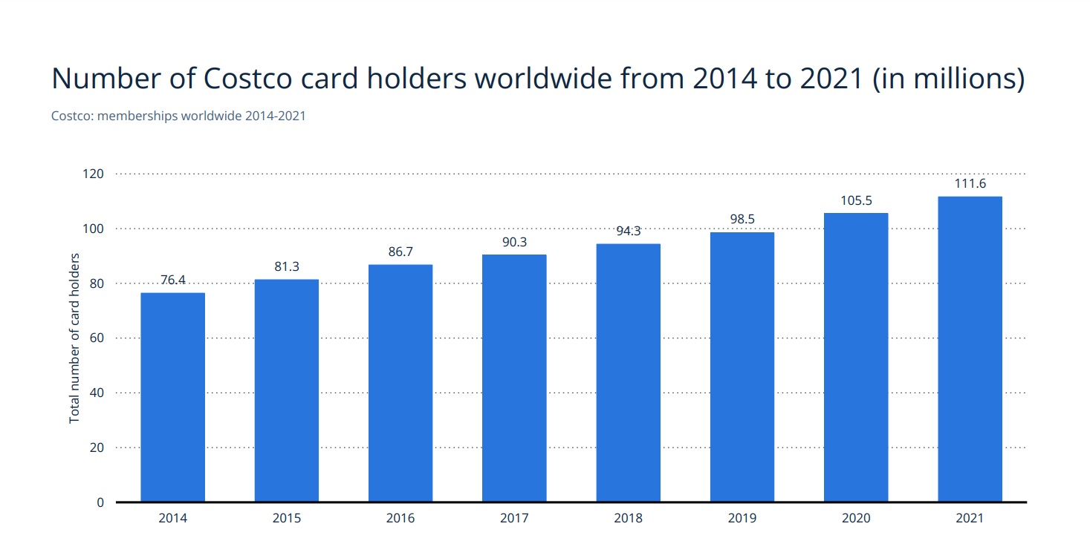
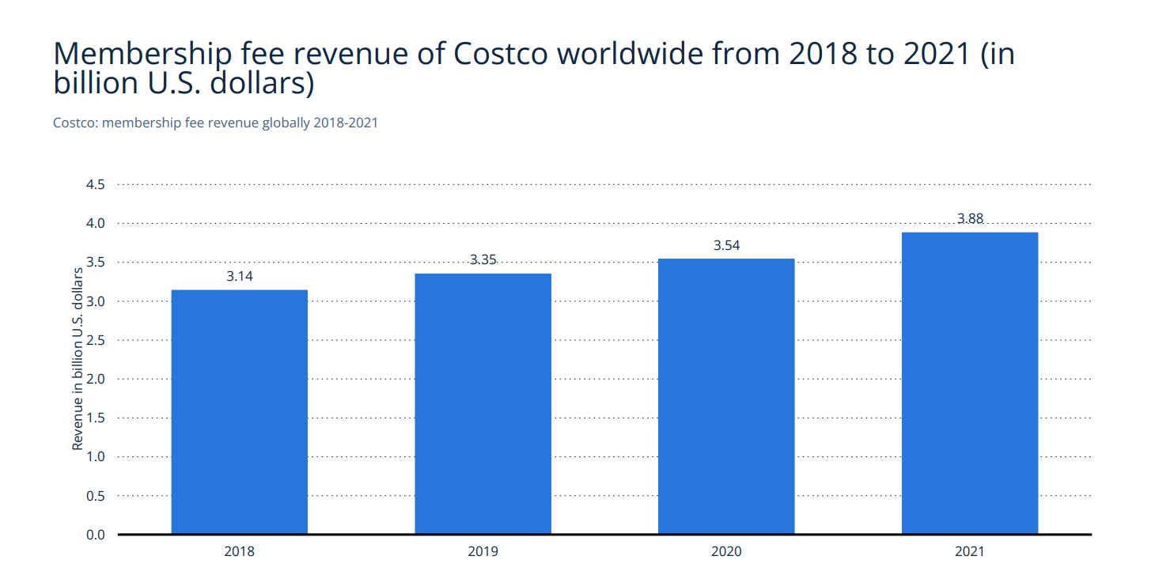
MARKET TRENDS: PRODUCT OR TREND
Industry Overview
Positioned for growth looking forward
Membership Graphs
Further highlights about memberships
Number of memberships and membership revenue
Key Indicators for a growing market in Diagnostics
Costco Wholesale Corporation is a growing membership-only retail company, which offers goods in bulk at competitive prices
In 2021, just over 111 million people had paid for a yearly Costco membership. The number of cardholders has been growing steadily since 2014
In 2021, the global membership fee revenue of Costco amounted to 3.88 billion U.S. dollars. In contrast, Sam's Club membership revenue amounted to 1.7 billion U.S. dollars
Sources: Statistica

Slide 7
I. Executive Summary
Industry Overview
Financial Overview
IV. Environmental, Social & Governance Analysis
V. Competitive Landscape
VI. Catalysts and risks
VII. Investment Rationale
VIII. Comps and DCF Models (Financial Models)

Slide 8
Historical data and financial highlights
5 Year Stock Data
Enterprise Value Walkthrough
Share Price ($) | $523.37
Shares Outstanding | 443.73 M
Equity Value | 231,646 M
Cash and Cash Equivalents | 11,67 M
Total Debt | 6,543 M
Preferred Shares | N/A
Minority Interest | 5 M
Enterprise Value | 219.230M
Revenue + Earnings
Key Metrics
Revenue / Earnings (Billions)
Metric | Data
Market Cap: | 223.68 B
Beta (5Y Monthly) | 0.78
PE Ratio (TTM) | 38.15x
52 week range: | 406.51 - 612.27
EPS | 13.23
EV / EBITDA | 21.96x
Sources: Costco Historical 10-K , Yahoo Finance
Sources: Costco Historical 10-K , Yahoo Finance

Slide 9
I. Executive Summary
Industry Overview
Financial Overview
IV. Environmental, Social & Governance Analysis
V. Competitive Landscape
VI. Catalysts and risks
VII. Investment Rationale
VIII. Comps and DCF Models (Financial Models)

Slide 10
ENVIRONMENTAL, SOCIAL & GOVERNANCE ANALYSIS
Analyst Commentary
ESG Analysis
Environmental
Social
Governance
-
Emission Reduction
Costco estimates that it can reduce cumulative Scope 1 and 2 CO2 emissions 20% by 2030 and 45% by 2035 from a 2020 base year.
To do so, it plans to reduce its refrigerant emission Global Warming Potential (GWP) by 30% by 2030 compared to its 2020 baseline.
Renewable energy
It will also increase purchased renewable electricity in its global operations to 30% by 2025, 60% by 2030, and 100% by 2035
Diversity
Costco is committed to working with qualified minority and women-owned suppliers.
Strong commitment to diversity and inclusion, winning several awards including “Best Company for Diversity,” “Best Company for Women,” and “Best CEOs for Women” among others.
Costco also ranks in the top 5% for diversity and inclusion among companies with 10,000+ employees, according to Comparably.
Leadership
Costco’s Board of Directors officially made sustainability a core part of the charter and responsibility for the Board’s Nominating and Governance Committee
Costco recently launched our ESG (Environmental, Social, and Governance) Executive Advisory Council, which brings together leaders from across the company to chart goals and strategies.
https://www.costco.com/sustainability-employees.html#:~:text=In%20the%20U.S.%2C%20we%20provide,for%20long%2Dtenured%20hourly%20employee.
https://www.comparably.com/companies/costco/diversity

Slide 11

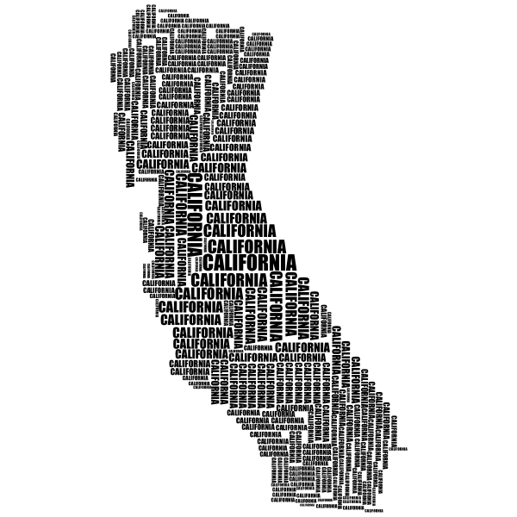
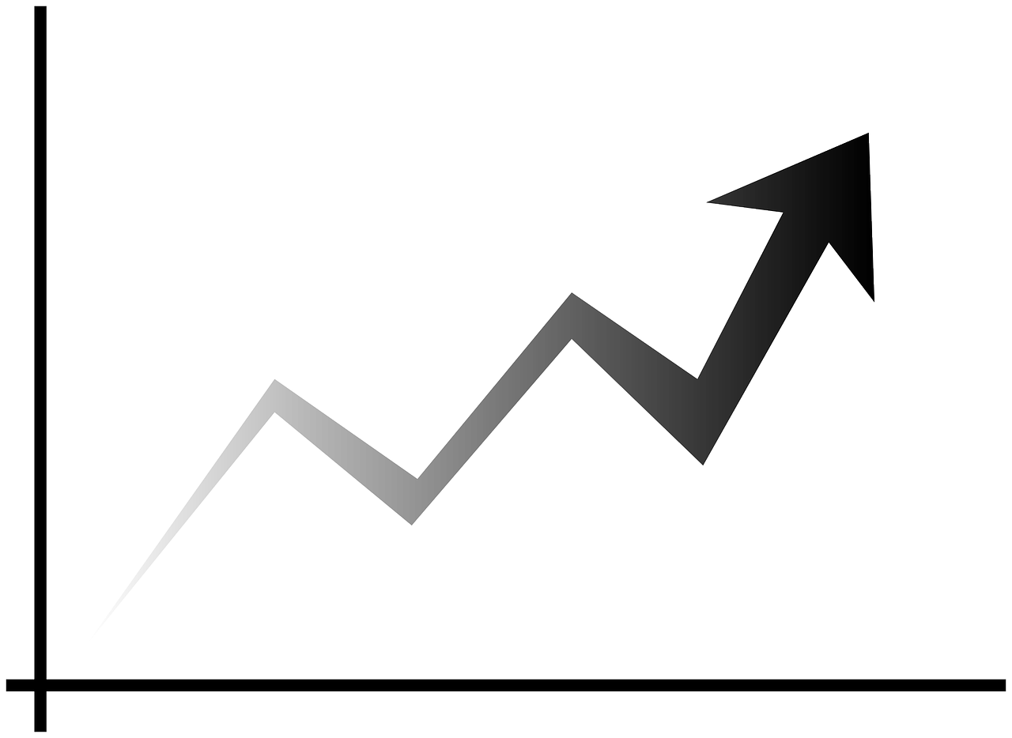




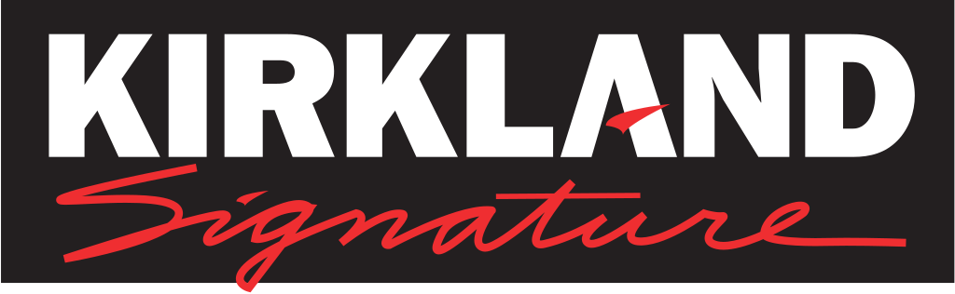
CATALYSTS & RISKS
Catalysts
Risks
Sales Momentum
Solid customer loyalty foundation with over 118 million cardholders worldwide, and that number continues to grow.
There is also a membership renewal rate of over 89%
Costco can increase membership fees with historically minimal resistance from existing customers.
Geographical Vulnerability
28% of Costco’s domestic sales come from California.
Changes in the domestic economy damage Costco’s sales.
Costco is also a defendant in several California lawsuits, many of which are class actions from former employees.
Ecommerce Opportunities
Costco is adapting to the growing demand for online shopping by launching eCommerce websites with same-day grocery delivery in most locations in the United States
Providing increasingly more in-store pickup options, creating a unique edge over competitors such as Amazon.
Supply Chain
As a global consumer retail firm, Costco is particularly vulnerable to supply chain disruptions.
This was specifically shown during the pandemic, which caused delays and considerable difficulties for Costco.
Earnings Reports
Costco recently reported another great quarter, closing out the fiscal year with a 16.56% increase in revenue.
There has been impressive growth as Costco’s low prices and excellent service continue to dominate the industry.
Kirkland Signature
Because Costco owns Kirkland Signature, if there is a quality issue related to the products, the company will not be able to command loyalty to the Kirkland Signature brand, causing a significant loss in profit.
Sources: Capital IQ, Company Filings, & Company Website
Notes:
Bayron

Slide 12
I. Executive Summary
Industry Overview
Financial Overview
IV. Environmental, Social & Governance Analysis
V. Competitive Landscape
VI. Catalysts and risks
VII. Investment Rationale
VIII. Comps and DCF Models (Financial Models)

Slide 13
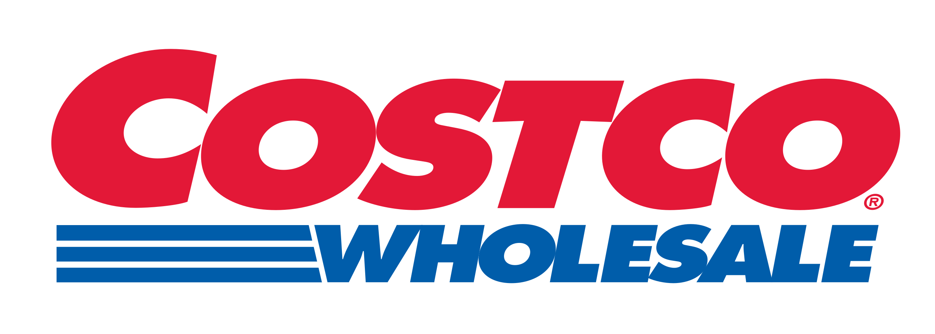

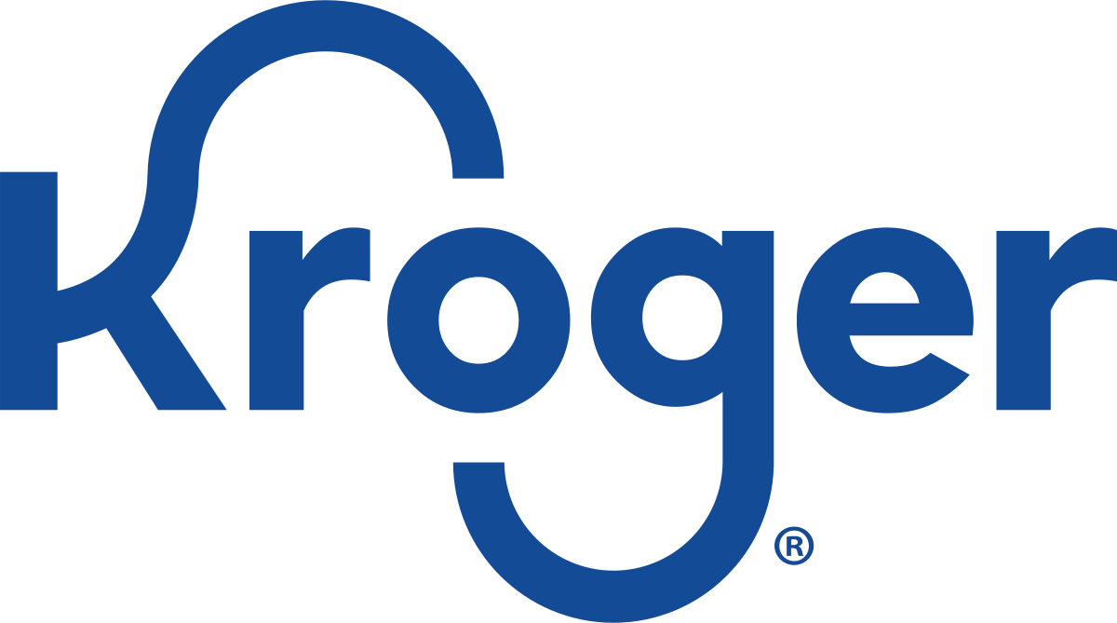
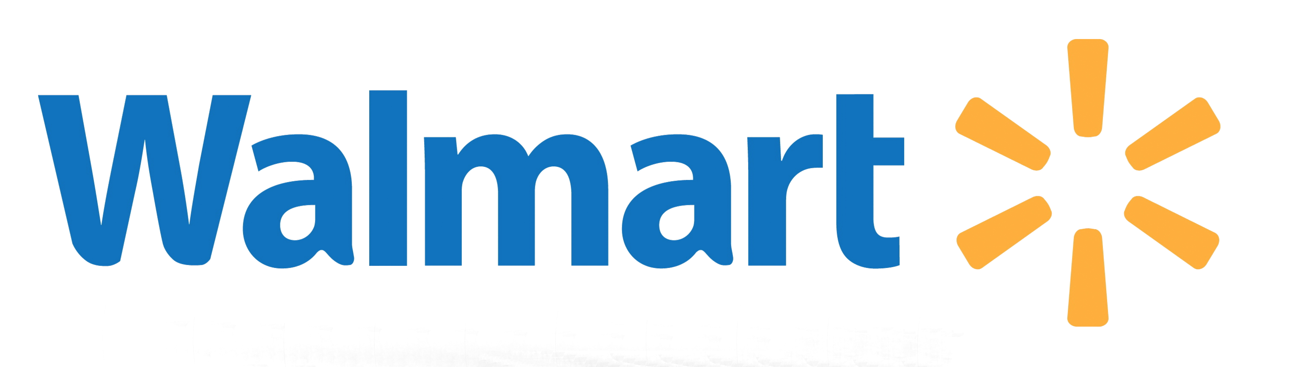
Competitive Landscape
Mkt Cap | $392.6B
Share Price | $145.60
Beta | .53
Mkt Cap | $79.35B
Share Price | $172.42
Beta | 1.04
Mkt Cap | $31.9B
Share Price | $44.60
Beta | .49
Engages in the retail sale of consumer products in North America and internationally
Over 11,500 stores globally and considered the largest retail chain in the world
In FY2020 Walmart’s total annual revenue was $524.4B and was ranked the 19th most valuable brand
Walmart also owns Sam’s Club, another membership-only wholesaler that competes with Costco
One of the largest retailers in the world
Target stores sell general merchandise products, including homewares, clothing, accessories, and food items.
In 2020 Target’s gross margins averaged out to 29% while Costco’s gross margins were only 13%
Has a membership program like Costco but does not charge annual membership fees
Products include premade shipping labels and ability for customers to comment on listings
One of the largest food retailers in the world operating in 35 US states
Built a partnership with online retailer Ocado, which has helped them expand
Has built a stronger eCommerce platform than Costco which boosted digital sales by 92% in 2020
Sources: Capital IQ, YahooFinance

Slide 14
I. Executive Summary
Industry Overview
Financial Overview
IV. Environmental, Social & Governance Analysis
V. Competitive Landscape
VI. Catalysts and risks
VII. Investment Rationale
VIII. Comps and DCF Models (Financial Models)

Slide 15
CATALYSTS & RISKS
Catalysts
Risks
Sales Momentum
Solid customer loyalty foundation with over 118 million cardholders worldwide, and that number continues to grow.
There is also a membership renewal rate of over 89%
Costco can increase membership fees with historically minimal resistance from existing customers.
Geographical Vulnerability
28% of Costco’s domestic sales come from California.
Changes in the domestic economy damage Costco’s sales.
Costco is also a defendant in several California lawsuits, many of which are class actions from former employees.
Ecommerce Opportunities
Costco is adapting to the growing demand for online shopping by launching eCommerce websites with same-day grocery delivery in most locations in the United States
Providing increasingly more in-store pickup options, creating a unique edge over competitors such as Amazon.
Supply Chain
As a global consumer retail firm, Costco is particularly vulnerable to supply chain disruptions.
This was specifically shown during the pandemic, which caused delays and considerable difficulties for Costco.
Earnings Reports
Costco recently reported another great quarter, closing out the fiscal year with a 16.56% increase in revenue.
There has been impressive growth as Costco’s low prices and excellent service continue to dominate the industry.
Kirkland Signature
Because Costco owns Kirkland Signature, if there is a quality issue related to the products, the company will not be able to command loyalty to the Kirkland Signature brand, causing a significant loss in profit.
Sources: Capital IQ, Company Filings, & Company Website

Slide 16
I. Executive Summary
Industry Overview
Financial Overview
IV. Environmental, Social & Governance Analysis
V. Competitive Landscape
VI. Catalysts and risks
VII. Investment Rationale
VIII. Comps and DCF Models (Financial Models)

Slide 17
Investment Rationale
1
Costco has been known to perform well in economic downturns with membership renewal rates at a staggering rate of 91% in the United States and Canada and 88% globally while still attracting new members
2
Costco is unique in that they minimally mark up offerings and pass along lower costs to their customers. This model gives them an edge over traditional retailers who rely on price mark ups. Deustche Bank has called them “Amazon Proof” because of this
3
Costco exceeds in the market because of their customer loyalty. Membership programs entice consumers to shop exclusively with Costco. Their customer service and culture also allows them to face less criticism
4
Costco is known to be a recession proof stock. Costco reported $71B in sales in the fiscal year of 2008, a 13% increase from the previous year- proving that the company can fight economic downturns
Sources: Market Watch, Fitch Ratings

Slide 18
I. Executive Summary
Industry Overview
Financial Overview
IV. Environmental, Social & Governance Analysis
V. Competitive Landscape
VI. Catalysts and risks
VII. Investment Rationale
VIII. Comps and DCF Models (Financial Models)

Slide 19
Comps and DCF Models (Financial Models)
Trading Comparable ($MM)
Capital IQ

Slide 20
Comps and DCF Models (Financial Models)
Historical P&L ($MM)
Capital IQ

Slide 21
THANK YOU

