Slide 1
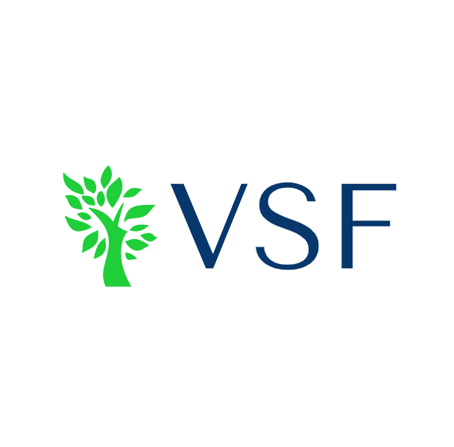
Current: $133.42 Target: $148.39 Time Horizon: 12-18 Months
Agilent Technologies (NYSE: A)
Industry Director: Bayron Quillay, Nikolas Pham
Analysts: Andrew Linn, Leroy Wang, Tarnvir Kullar. Ryan Harris, Aidan Wisherd

Slide 2
Company Overview
Business Description
Agilent is a leader in life sciences, diagnostics and applied chemical markets.
The company provides laboratories worldwide with instruments, services, consumables, applications and expertise enabling customers to gain the insights they seek.
Three major business segments
Analytical laboratory equipment such as chromatography, spectrometers, sequencing equipment, etc. (Life Sciences and Applied Markets)
Services, consumables and lab-wide resource management to help laboratories improve efficiency, optimize operations, and develop user skills (Cross Lab Group)
Pathology, genomics, nucleic acid equipment, and clinical testing (Diagnostics and Genomics Group)
Revenue by Business Segment
Revenue by Geography
40%
Sources: Capital IQ, Company Website, Company Financials
Notes:
Cross lab group: lab consulting, repair, updates, operation management systems. Not just Agilent manufactures
Life Sci and Cross lab go hand in hand, both include same customers
Online systems to help run lab better
Cross lab – ability to fix machines in the lab instead of buying another

Slide 3
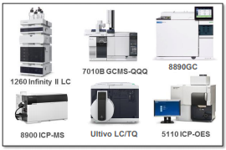
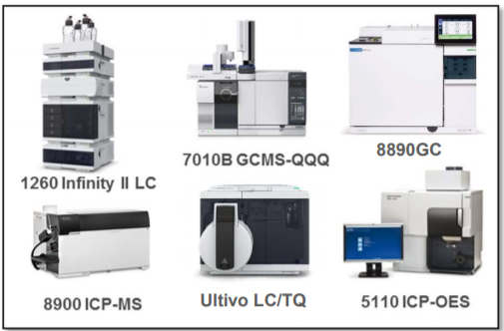
Industry Overview
Life Sciences and Applied Markets
Spectroscopy and chromatography are the two most powerful and commonly used tools in analytical chemistry
Can separate mixtures into their individual components for mixture analysis
Analytical equipment and basic laboratory supplies is needed in academia, pharmaceuticals, research, and medicine.
Cross Lab Group
Laboratory information management systems help with lab workflow and operational efficiency
On-demand laboratory equipment updates and repairs is important
Analytical Devices
Global Lab Equipment Market Growth
CAGR: 13.4%
Sources: Agilent Tech. website, MarketsandMarkets,
Notes:
Isotopes, same number of protons, dif number of neutrons
These machines are the biggest source of revenue
Global lab equipment graph – a growing field

Slide 4
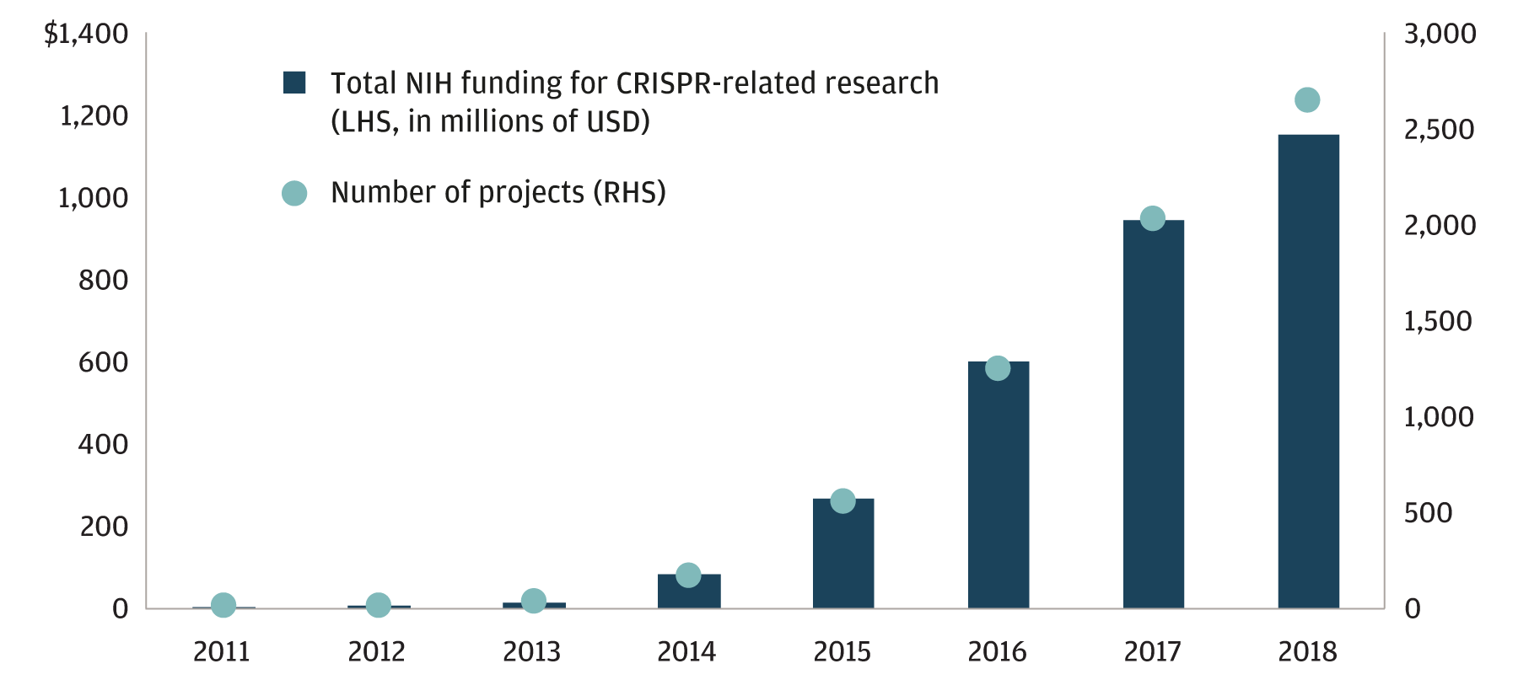
Industry Overview
Genomics & Diagnostics
CRISPR is a new genetic engineering technique that can accurately modify genomes of organisms.
Much more accurate and efficient compared to previous techniques
Applications in medicine, agriculture, food, and diagnostics
Pathology and cancer labs require advance laboratory equipment for clinical diagnostics
Recent technological advancements such as tumor staining, next-gen sequencing, in-vivo mass spec.
CRISPR-Cas9 Gene Editing Growth
Global Next-Gen Sequencing Market Size
CAGR: 22%
Sources: Yole Development CRISPR Market Overview, JPMorgan.com, illumina.com, FortuneBusinessInsights.com
Notes:
https://www.slideshare.net/Yole_Developpement/crispr-technology-market-overview-from-lab-to-industry-2018-report-by-yole-developpement-120311808
https://www.researchgate.net/publication/322642476_History_of_CRISPR-Cas_from_Encounter_with_a_Mysterious_Repeated_Sequence_to_Genome_Editing_Technology
In July 2019, CRISPR was used to experimentally treat a patient with a genetic disorder. The patient was a 34-year-old woman with sickle cell disease.^{[178]}
In February 2020, progress was made on HIV treatments with 60-80% of the DNA removed in mice and some being completely free from the virus after edits involving both LASER ART, a new anti-retroviral therapy, and CRISPR.^{[179]}
In March 2020, CRISPR-modified virus was injected into a patient's eye in an attempt to treat Leber congenital amaurosis.^{[180]}
In the future, CRISPR gene editing could potentially be used to create new species or revive extinct species from closely related ones.^{[181]}
CRISPR-based re-evaluations of claims for gene-disease relationships have led to the discovery of potentially important anomalies.^{[182]}
When comparing next-generation sequencing (NGS) vs. qPCR technologies, the key difference is discovery power. While both offer highly sensitive and reliable variant detection, qPCR can only detect known sequences. In contrast, NGS is a hypothesis-free approach that does not require prior knowledge of sequence information
Genomic era of cancer research and treatment

Slide 5
Acquisition History
2001: Objective Systems Integrators Inc.
2002: RedSwitch
2004: Silicon Genetics
2007: Stratagene, Velocity11, Adaptif, Kalabie and NetworkFab
2010: Varian, Inc*
2012: Dako*
2015: Seahorse Bioscience and Cartagenia
2016: Multiplicom N.V.*
2017: Cobalt Light System
2018: Lasergen, Inc., Advanced Analytical Technologies, Inc., and Luxcel Biosciences
2021: Resolution Bioscience Inc.
2019: BioTek Instruments
Sources: Company Website
Notes:
2021 acquisition wasn’t shit load of money, next genome sequencing
Main acquisitions (highlights)

Slide 6
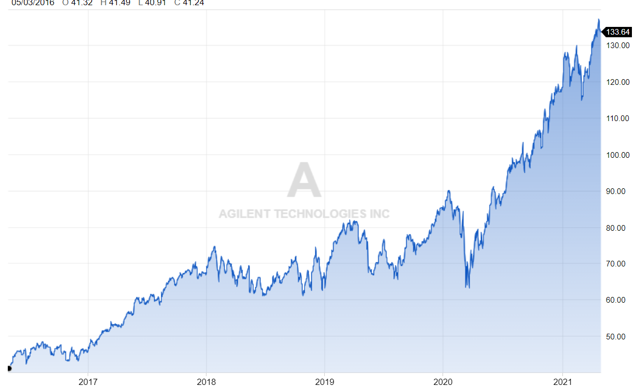
Financial Overview
Acquisitions
5 Year Price Chart
52 Wk High: $137.83 (4/26/21 - Also ATH)
52 Wk Low: $73.42 (5/4/20)
Beta: 0.91
4
Notes:
Andrew

Slide 7
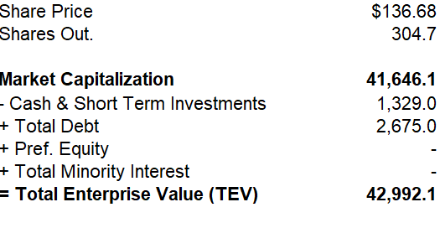
Financial Overview
Key Metrics
Enterprise Value Walkthrough
Market Cap: | $41.65B
Gross Profit Margin TTM: | 14.65%
Current Ratio MRQ: | 2.07
Return on Equity TTM: | 16.86%
Price/Earnings TTM: | 52.57
Price/Free Cash Flow TTM: | 38.14
Financial Highlights
Revenue increased from $4.2B to $5.34B over last 5 years (+27%)
Net Income increased from $462M to $719M over last 5 years (+56%)
All 3 business segments had revenue increases from FY 2019 to FY 2020
Agilent paid $222M in dividends during FY 2020, which was 31% of their Net Income
Shares outstanding down 5% over last 5 years
4
Notes:
Andrew
Pass to Ryan

Slide 8
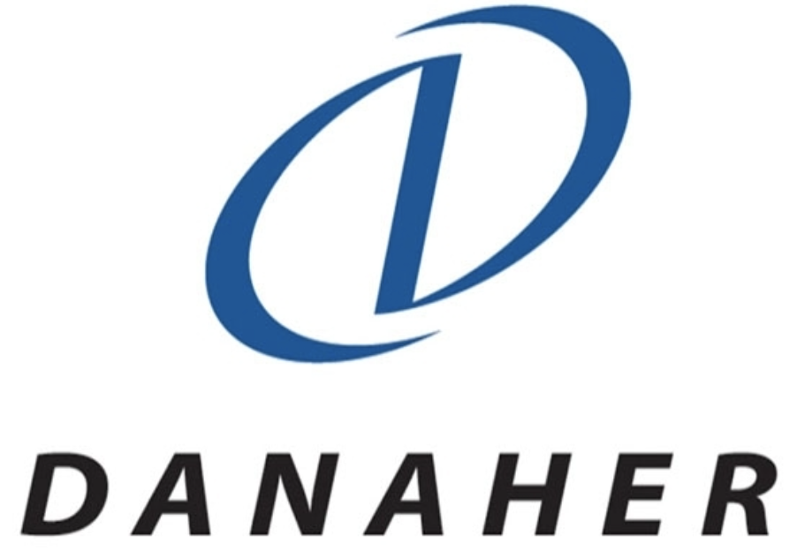
Competitive Landscape
Mkt Cap | 183.46 bil
Share Price | 466.81
Beta | 0.77
Mkt Cap | 181.13 bil
Share Price | 253.94
Beta | 0.61
Mkt Cap | 212.73 bil
Share Price | 120.08
Beta | 0.70
Makes instruments, equipment, software, services and consumables for healthcare and life science laboratories
Less growth potential and return on capital at a high pricepoint. More of a 5–10-year risk-averse type of hold with not much EPS growth.
Designs, manufactures, and markets professional, medical, industrial, and commercial products and services for their life sciences, diagnostics, and applied solutions businesses
Trades at 40x earnings but not much upside beyond 2021 with less demand from COVID
Makes products in four areas: medical devices, nutritionals, diagnostics, and generic pharmaceuticals
Slowdown in growth from Q4 2020 to Q1 2021 due to less COVID testing. New at home COVID testing product but that is not enough to keep up 35% annual growth
Sources: Capital IQ, Investor Presentations
Notes:
As you can see, these three competitors are all larger companies than Agilent, strictly from a market cap and valuation perspective. In general, the medical devices sector is a growing industry and all of these companies including Agilent are expected to grow via M&A but also organically within this industry.
It will be essential for Agilent to continue with its aggressive M&A practices to continue to grow and maintain their competitive positions
Specifically, becoming a market leader in genetic engineering would be a solid revenue driver for the company, however it would require Agilent to make some larger scale acquisitions than they have previously.
Noting that their competitors are all larger companies, Agilent could possibly get out bid for these deals, but larger scale transactions are not out of the question for them as they have a solid Free Cash Flow portfolio to compete with the likes of Thermofisher, Danaher, and Abbott.
With healthcare in general, there is tons of consolidation in all different aspects of the industry. We expect no different in the diagnostics and research sector. Although Agilent is defined as a midsized corporation, it has the M&A portfolio and financial flexibility to not only compete but thrive in this market.

Slide 9
ESG Analysis
Environmental
Social
Governance
Notable Rankings
Most sustainable U.S. healthcare company according to Barron’s 100 Sustainable Companies
Ranked as fifth lowest ESG risk out of 847 companies in the United States pharmaceutical industry
Greenhouse Gas Emissions
21 percent decrease in Scope 1 + Scope 2 GHG emissions between 2018 and 2019
Reducing Water Consumption
19 percent reduction in water consumption by headcount in 2019
Waste Diversion Policy
85 percent diversion from solid waste in landfills
94 percent diversion from landfills for all forms of waste
Philanthropy
$7.5 Million donated to charities, hospitals, research and universities in 2019
Spend over $5 million annually for the advancement of science globally
Match charitable contributions by employees
Employees given six paid days off a year for company-sponsored or approved community activities and volunteering
Equitability
One of Forbes Top 100 Best Employers for Diversity in 2021
Ranked among Forbes Best Employers for Women
Supply Chain
All suppliers must adhere to code of conduct that spans environmental policies, human rights, employee rights, health and safety
Third-party firm monitors adherence to all human trafficking, labor and slavery laws
Political Influence and Corruption
Analysis of all units of business for risks of corruption
Suppliers reviewed to ensure compliance with all anti-corruption laws
No PAC participation

Slide 10
Catalyst and Risks
Catalysts
Risks
Biotech industry itself expected to reach USD 2.44T by 2028, with DNA sequencing being the second largest industry within biotech.
Agilent expanded into the Cannabis sector in 2021, partnering with Ionization Labs for global product potency testing.
Recently acquired Resolution Bioscience, a group leading in next generation oncological sequencing technology.
Larger presence in small molecule drug research field, which is being quickly overtaken by biologic drug discovery.
Genetics is a relatively new medical field, considered to be incredibly volatile and risky.
Notes:
Risks- competitors, genome space and china business due to political climate

Slide 11
Investment Rationale
Strong Financials, Continued Growth
Revenue Growth Past 5 Years
Agilent has a very strong balance sheet
It's assets more than double its liabilities
36.16% increase in cash flow over the past year
Revenue has consistently grown over the past 5 years
All 3 business groups had double digit growth in Q1
COVID pandemic has furthered this explosive growth due to their range of products
Involvement in genomics and diagnostics
It furthers Agilent's participation in NGS tech, opening up a market that will reach $3 Billion by 2025 and is estimated to double by 2030
Continued focus on essential laboratory equipment and services
Faster, more efficient laboratory equipment and workflow will always be sought out after
Have continued to experience strong top line growth after the divestment of their electronic measurement portfolio in 2014
Sources: Agilent Technologies, MarketMarket, WeBull
Notes:
Consistently developing new products: diagnostic in vitrio LC/MS system, Dako Omnis (only one of its kind)
Life science and cross lab are tied together

Slide 12
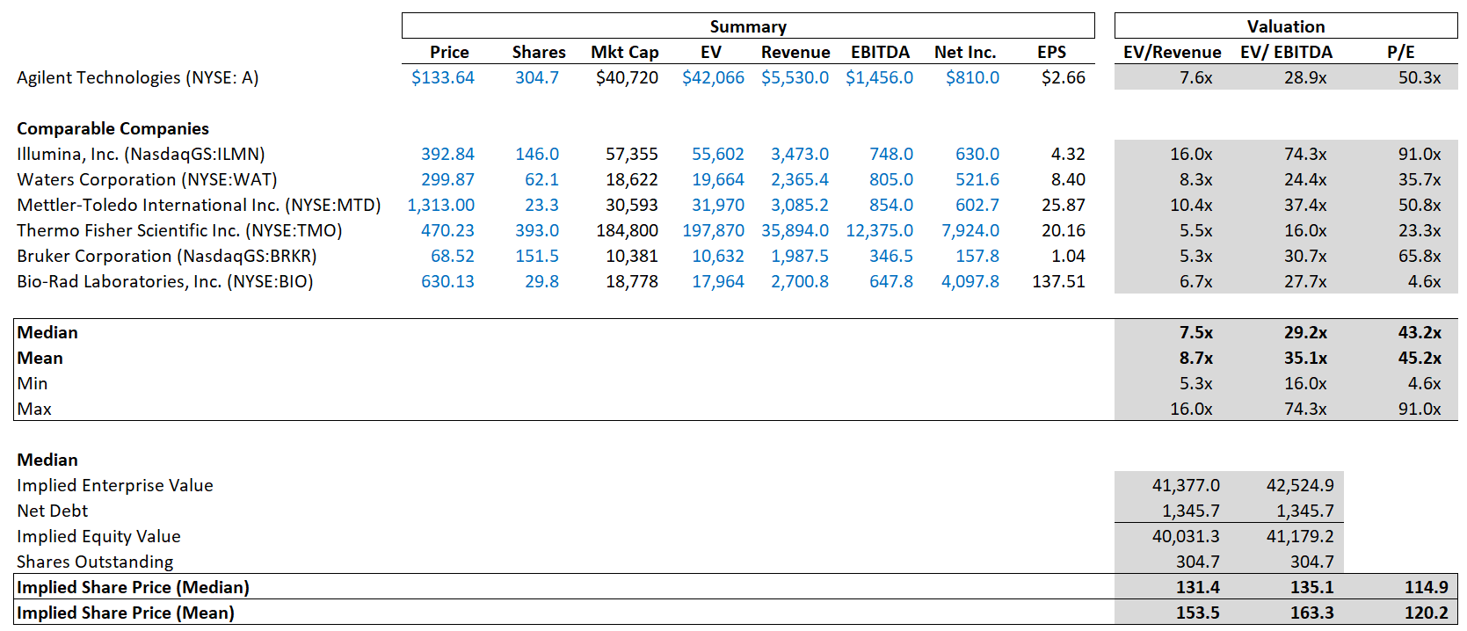
Public Comparable
Sources: Capital IQ, Company Website, Company Financials
Notes:
Andrew

Slide 13
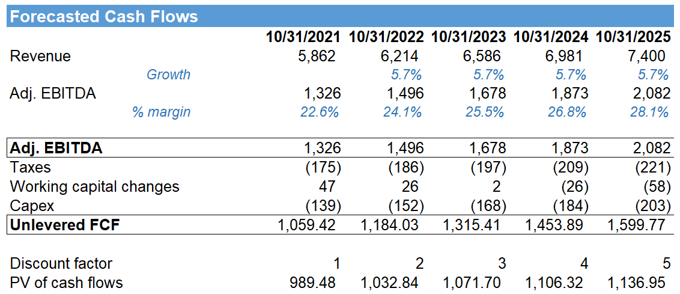
DCF
Sources: Capital IQ, Company Website, Company Financials
Notes:
Even the company assumes a 6.5%

Slide 14
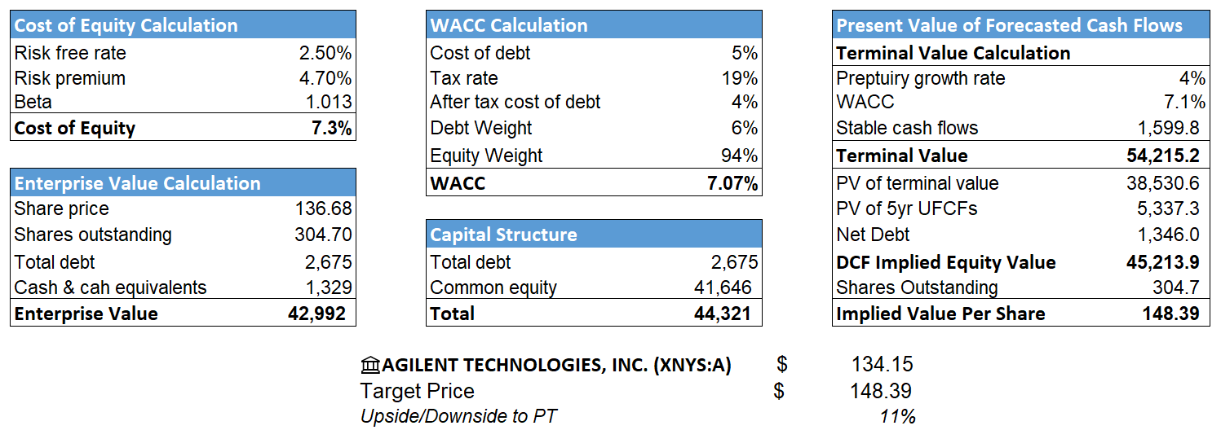
DCF Output
$ 133.42
Sources: Capital IQ, Company Website, Company Financials, S&P Global Equity Research, JPM Equity Research

Slide 15
Q&A

