Slide 1
Current Price: 119.94
Target Price: 138.69 (15.6% upside)
Time Horizon: 12-18 months
Director: Bayron Quillay
Analysts: Ryan Harris, Ahmed Abbasy, Anthony Eduafo
Notes:
Bayron

Slide 2
I. Executive Summary
Industry Overview
Financial Overview
IV. Environmental, Social & Governance Analysis
V. Competitive Landscape
VI. Catalysts and risks
VII. Investment Rationale
VIII. Comps and DCF Models (Financial Models)

Slide 3
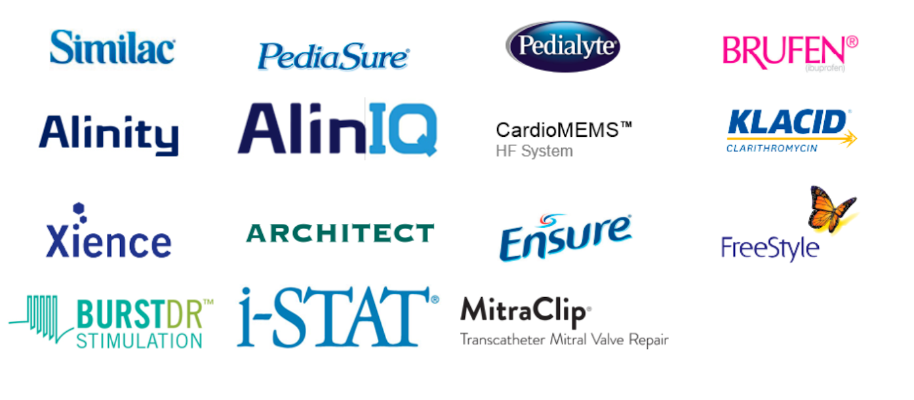
Abbott Overview
Executive Summary
Overview
Company Highlights
Headquarters: North Chicago, Illinois.
Founded: 1888
Employees: 109 000
Description: Abbott Laboratories discovers, develops, manufactures, and sells health care products worldwide. The company creates breakthrough products - in diagnostics, medical devices, nutrition, and branded generic pharmaceuticals- that help families and communities lead healthier lives, full of unlimited possibilities.
130+ years of
discovering new ways to make life better
Making a difference in over 160 + years
109,000 employees working around the world to make a lasting impact on health
Segments
Advancing Innovation
Abbott is constantly advancing innovation
Nutrition
Medical Devices
Pharmaceutical
Diagnostics
Pioneering Diabetes Management
Neuromodulation
Taking diagnostics to new heights
Ground-breaking sensing technology displays glucose with a scan
Innovative devices for chronic pain movement disorders
An unprecedented approach to provide a more efficient complete diagnostics solution
Trusted Brands
Company Market Leadership
Abbott is a market leader in the following areas
Glucose monitoring
Blood and plasma screening
Adult nutrition
Pediatric nutrition
Heart pump (LVADs)
Remote heart failure monitoring
Point of care testing
Chronic pain devices
Sources: Capital IQ, Company Filings, & Company Websites
Notes:
Anthony or Bayron

Slide 4
I. Executive Summary
Industry Overview
Financial Overview
IV. Environmental, Social & Governance Analysis
V. Competitive Landscape
VI. Catalysts and risks
VII. Investment Rationale
VIII. Comps and DCF Models (Financial Models)

Slide 5
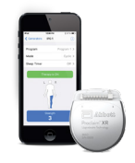
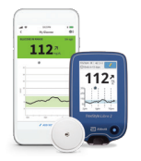
Market Trends: Medical Devices
Industry Overview
Through the pandemic, there has been a greater impotence on medical devices and diagnostic testing
Medical Devices Market
Medical Devices Market
Key Indicators for a growing market in Medical Devices
Y/Y Growth in Medical Device Manufacturing ($ in billions)
Surging Incidence of Chronic Disease
Increasing incidence and prevalence rates of chronic diseases, such as diabetes and heart failure
The increase in diagnostic examinations fuels the growth rate of the medical devices market
$ in billions
Emergence of New and Hassle-Free Medical Devices
Innovative home monitoring medical devices has allowed patients and healthcare providers to remotely monitor vital signs
Years
Continuous Glucose Monitoring
Increasing Geriatric Population
Rising elderly population across different countries indirectly rises the usage of medical devices for different vital functions
A growing geriatric population primarily in Asia, following North America and Europe
Chronic Pain Device
Sources: IBISWorld, Abbott, Pfizer, AbbVie, Medtronic, Eli Lilly and Comapny
Notes:
Bayron

Slide 6
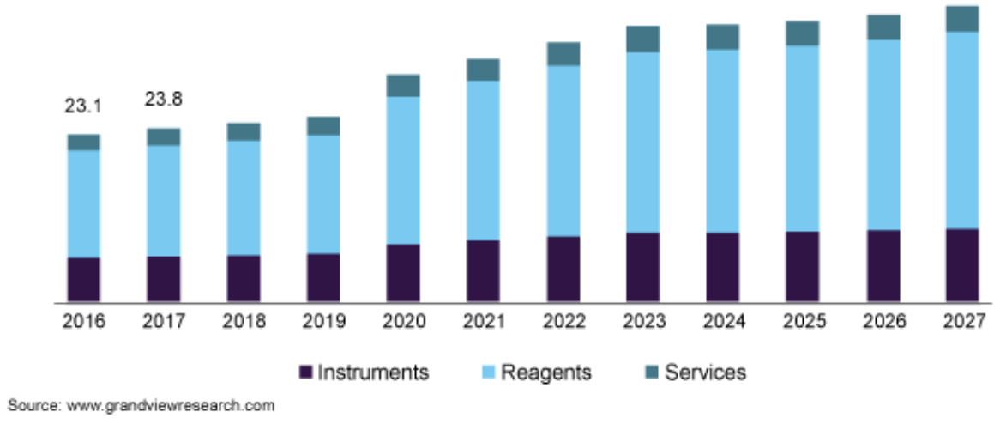
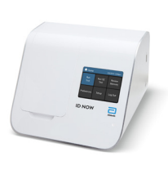
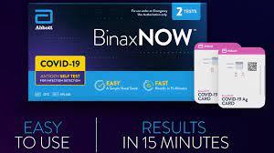
Market Trends: Diagnostics
Industry Overview
Through the pandemic, there has been a greater impotence on medical devices and diagnostic testing
Diagnostics Market
Diagnostics Market
Market Growth in Diagnostics segmented by Product Type
Key Indicators for a growing market in Diagnostics
Market Size
Worth $63 billion globally and expected to reach $94 bn by 2026
North America is the largest market for diagnostics while the Asia Pacific is the fastest-growing geography
COVID-19 Impact
COVID-19 has exponentially driven growth with increased lab testing, an upsurge in patients, and more government funding
Segmented into four areas: Test, Product, End User, and Geography
COVID-19 Testing
Diagnostic Testing
The Future of the Industry
Majority of chronic disease growth occurs in emerging markets
Clinical diagnostics assist with prevention and intervention which should propel the overall market
Sources: Modor Intelligence
Notes:
Ryan
#1 Point-of-care testing
#1 Infectious disease testing
#1 Blood and plasma serology screening
A leader in COVID-19 testing

Slide 7
I. Executive Summary
Industry Overview
Financial Overview
IV. Environmental, Social & Governance Analysis
V. Competitive Landscape
VI. Catalysts and risks
VII. Investment Rationale
VIII. Comps and DCF Models (Financial Models)

Slide 8
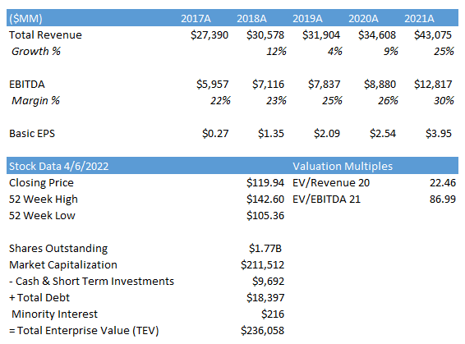
Historical data and financial highlights
Financial Overview
Revenue Highlights
Management expectations for Q1:
At least $1.50 EPS
Consistent Total Revenue Increase
57% Growth
Over 5-year Period
Continuous EPS Growth
Over 5-Year Period
EBITDA has increased by 110% over 5-Year period
Adult Nutrition Brand sales increased 8.1% from 2020 Q4
Higher Diagnostic Revenue: $4.47B
Beat estimates
Stability in Revenue in Q4
Capital IQ
Notes:
Ahmed

Slide 9
Stock Chart & Enterprise Value
Financial Overview
5 Year Stock Data
Enterprise Value Calculation ($MM)
Sources: Capital IQ & Company Filings
Notes:
Ahmed

Slide 10
I. Executive Summary
Industry Overview
Financial Overview
IV. Environmental, Social & Governance Analysis
V. Competitive Landscape
VI. Catalysts and risks
VII. Investment Rationale
VIII. Comps and DCF Models (Financial Models)

Slide 11
Environmental, social & governance analysis
Analyst Commentary
ESG Analysis
Environmental
Social
Governance
-
Green House Gases
Announced a 30% reduction of absolute Scope 1 and Scope 2 emissions by 2030
Resource Depletion
Implement accredited water stewardship management practices in more than 75% of manufacturing sites in water-stressed areas
Use a circular economy approach to achieve and maintain at least a 90% waste diversion rate.
Diversity
Increase spending with diverse and small businesses 50% by 2030, and Black- and women-owned businesses 150% by 2025, from a 2020 baseline.
Ensure gender balance in STEM roles with at least 45% female representation.
Aim for 1/3 of our leadership roles are held by people from underrepresented groups by 2025.
Maintain leadership accountability by tying executive compensation to diversity outcomes.
Supply Chain
Certify that 80% of newly contracted direct material spends are linked to contracts that incorporate social responsibility requirements.
Ensure ethical sourcing from all suppliers with high-risk sustainability factors through 100% auditing
Notable Mentions
Recently named 100 Best ESG Companies by Investor’s Business Daily
Top Industry Score in Sustainability out of 84 companies in the S&P Global Corporate Sustainability Assessment
Leader in the Health Care Equipment & Supplies sector for nine consecutive years and included on broader Dow Jones Sustainability Index (DJSI) for 17 consecutive years
https://www.abbott.com/corpnewsroom/sustainability/top-industry-score-in-sustainability-for-9th-year.html
Notes:
Bayron

Slide 12
I. Executive Summary
Industry Overview
Financial Overview
IV. Environmental, Social & Governance Analysis
V. Competitive Landscape
VI. Catalysts and risks
VII. Investment Rationale
VIII. Comps and DCF Models (Financial Models)

Slide 13
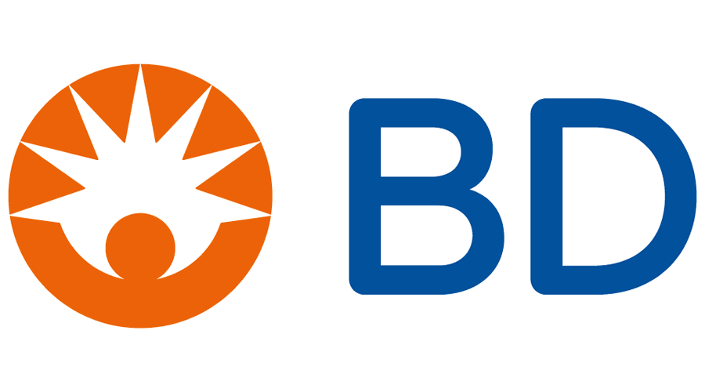
Competitive Landscape
Founded | 1886
Market Cap | 477.355B
Share Price | $181.46
P/E | 23.24
Beta | 0.72
Founded | 1949
Market Cap | 150.091B
Share Price | $111.52
P/E | 30.83
Beta | 0.75
Founded | 1897
Market Cap | 76.915B
Share Price | 270.04
P/E | 46.92
Beta | 0.65
Overview
Pharmaceutical: Develops and markets a wide range of synthetic and biologic drugs. JNJ’s most important therapeutic areas are Immunology drugs that treat autoimmune diseases, Oncology drugs, Neuroscience drugs, and Cardiovascular drugs
Medical Devices: Sells a wide range of health care products, including wound care, surgical instruments and implants, hip and knee replacements, and spinal implants
Consumer: Sells a wide variety of personal care products, including over-the-counter medicines, adult skin and hair care products, baby care, oral care, first aid, women’s health, and nutritional supplements.
Overview
Cardiovascular: Portfolio is comprised of the 1) Cardiac Rhythm and Heart Failure (CRHF) Disease Management division, 2) Structural Heart & Aortic division and the 3) Coronary & Peripheral Vascular division.
Medical Surgical: Portfolio consists of the 1) Surgical Innovations division, and the 2) Respiratory, Gastrointestinal & Renal division.
Neuroscience: Portfolio is made up of the Cranial & Spinal Technologies, Specialty Therapies, and Neuromodulation divisions.
Diabetes: Develops, manufactures, and markets products and services for the management of Type I and Type II diabetes.
Overview
A global medical technology company engaged in the development, manufacture, and sale of a broad range of medical supplies, devices, laboratory equipment, and diagnostic products used by healthcare institutions, life science researchers, clinical laboratories, the pharmaceutical industry and the public.
One of the first companies to sell U.S.-made glass syringes and is a pioneer in the production of hypodermic needles.
Traditionally had two business segments, BD Medical and BD Life Sciences, until the December 2017 acquisition of C.R. Bard (BCR), after which, the company expanded to a third segment, BD Interventional.
Sources: FactSet & Company Pages
Notes:
Bayron

Slide 14
I. Executive Summary
Industry Overview
Financial Overview
IV. Environmental, Social & Governance Analysis
V. Competitive Landscape
VI. Catalysts and risks
VII. Investment Rationale
VIII. Comps and DCF Models (Financial Models)

Slide 15
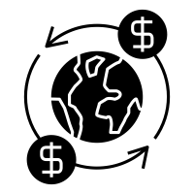
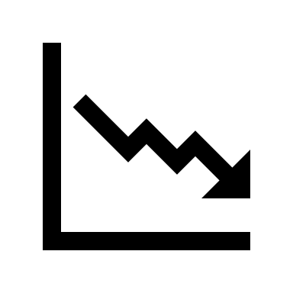
Catalysts & Risks
Catalysts
Risks
Structured Heart Portfolio
Recent U.S. FDA approval of two key minimally invasive devices, the Amplatzer Amulet Left Atrial Appendage (LAA) Occluder and Portcio with FlexNav transcatheter aortic valve replacement (TAVR) system
Abbott’s macro exposure
To emerging markets within their pharmaceuticals business
India, Brazil, Russia, China
Peripheral Vascular Offering
Abbott’s acquisition of Walk Vascular, LLC, a medical device company with a minimally invasive thrombectomy system designed to remove peripheral blood clots
Pipeline and new product launches disappointments
Regulatory delays
Weak execution
Diabetes Care
From glucose monitoring systems to personal and professional continuous glucose monitoring devices
FreeStyle Family
Libre Sense
Rapid decrease in COVID-19 related testing
Their $5 BinaxNOW antigen test helps people determine if they have COVID-19 within 15 minutes
Bottom line revenues for this could be affected as a result of the decline of COVID-19 testing
Virtual Care Growth Opportunity
Abbott recently launched a first-of-its-kind technology, Neutrosphere Virtual Clinic, which allows patients to communicate with physicians, ensure proper setting and functionality, and receive new treatment settings remotely
Sources: Capital IQ, Company Filings, & Company Website
Notes:
Bayron

Slide 16
I. Executive Summary
Industry Overview
Financial Overview
IV. Environmental, Social & Governance Analysis
V. Competitive Landscape
VI. Catalysts and risks
VII. Investment Rationale
VIII. Comps and DCF Models (Financial Models)

Slide 17
Investment Rationale
1
Optimistic Q4 Earnings
Multiple areas of the company beat Q4 earnings predictions
Reported EPS of $1.32 and revenue of $11.5 billion
Since Q4 2020, Total Sales grew 15.6%: Nutrition 10.4%, Diagnostics 20.5%, and Medical Devices 12.3% in the US
2
Diagnostics Growth
Over the past year, COVID has been a large growth driver for Abbott, and still is after reporting $2 billion in sales for COVID tests
It remains attractive, as the non-COVID areas of the business have steadily grown as well
Excluding COVID testing, molecular diagnostics revenue grew 15% YOY
Generic drugs enjoyed strong sales internationally, namely in China, India, and Russia
3
Medical Devices
Sales soared 18.5% from pre-pandemic levels in 2019, increased by 5% internationally
Abbott's FreeStyle Libre and Libre Sense diabetes devices had Q3 sales of $1 billion, up 41.6% YOY
Recently won FDA approval for a new stroke-prevention device in August
FDA approval for new aortic valve replacement system to help patients with a high risk of requiring open heart surgery
Acquired Walk Vascular in Q3, great fit for Abbott's vascular medical devices business
4
Product Pipeline
FDA extends expiration date to 15 months for BinaxNow Ag Card Home Test
Received FDA clearance for new cardiac mapping system EnSite that improves how doctors treat abnormal heart rhythms
Developing a new category of biowearables called Lingo that track and measure your general health and wellness
Sources: Market Watch, Fitch Ratings
Notes:
Ryan
Sales soared 18.5% from pre-pandemic levels in 2019, increased by 5% internationally compared to the US in the last year

Slide 18
I. Executive Summary
Industry Overview
Financial Overview
IV. Environmental, Social & Governance Analysis
V. Competitive Landscape
VI. Catalysts and risks
VII. Investment Rationale
VIII. Comps and DCF Models (Financial Models)

Slide 19
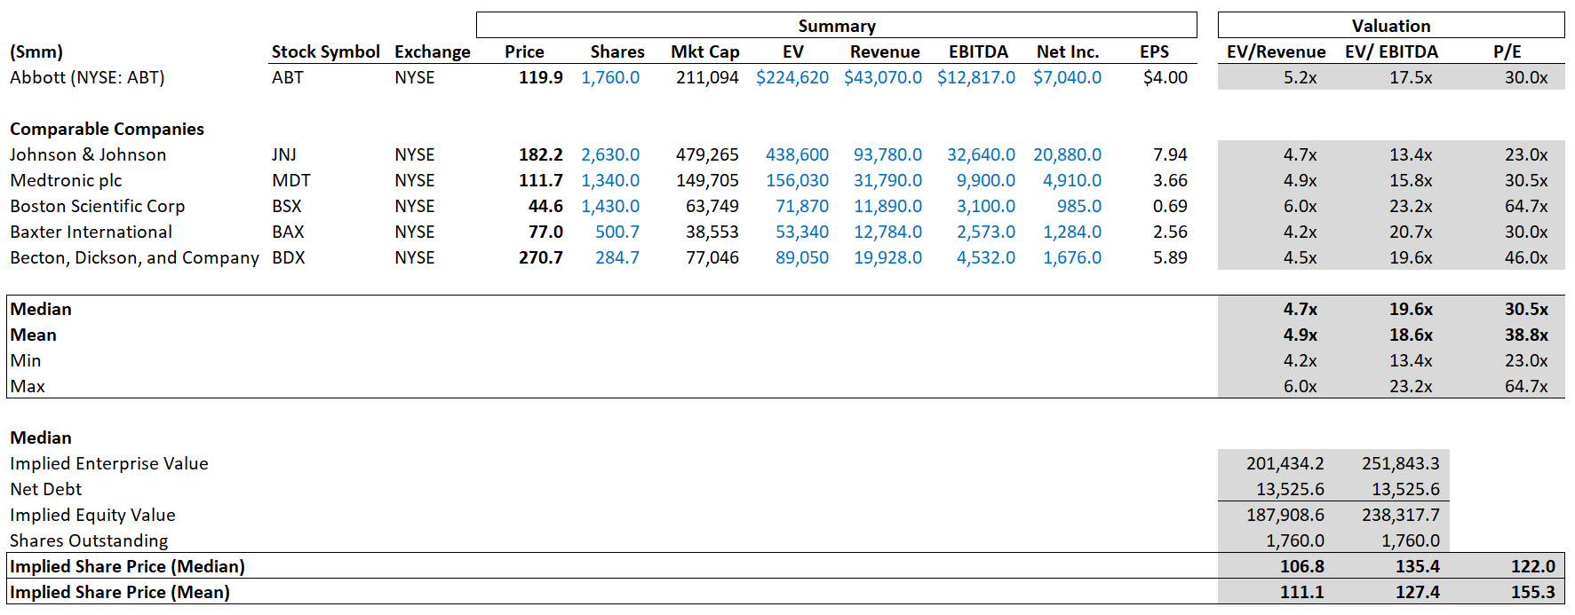
Comps and DCF Models (Financial Models)
Trading Comparable ($MM)
Capital IQ
Notes:
Bayron

Slide 20
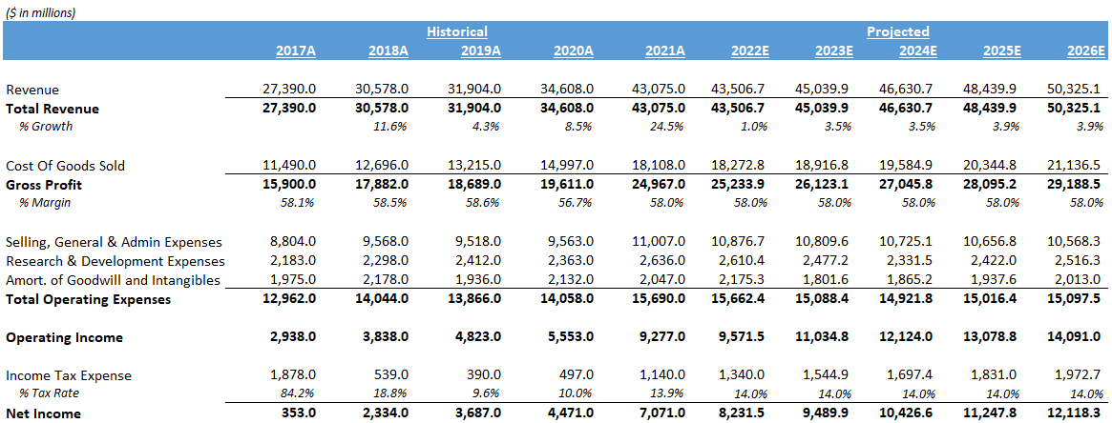
Comps and DCF Models (Financial Models)
Historical and Projected P&L ($MM)
Capital IQ
Notes:
Bayron

Slide 21
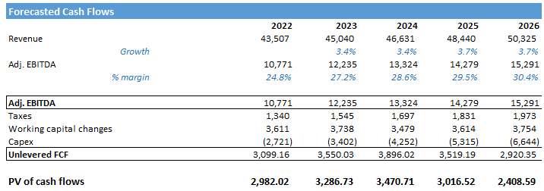
Comps and DCF Models (Financial Models)
Discounted Cash Flow ($MM)
Assumptions
Capital IQ
Notes:
Bayron

Slide 22
THANK YOU

