Slide 1
Current: $155.39 Target Price $197.75 (+27.26%) Time Horizon: 14-22 months
ETSY (NASDAQ: ETSY)
Directors: Duncan Webber
Analysts: Yuchen Y, Albert C, Ali S, Lauryn O, Sarah G,

Slide 2
Company Overview
Business Description
Business Highlights
In August 2019, ETSY acquired Reverb, a leading online marketplace for new, used and vintage Musical Instruments for $275 million in cash.
80% of Etsy customers are repeat purchases (high retention rate)
Etsy is an online marketplace where independent crafters, artists and collectors sell vintage, handmade and custom products.
The company was founded in 2005, went public in April 2015, and is based in Brooklyn, NY.
Etsy has 81.9 million active buyers, and 4.4 million active sellers from 234 countries.
Revenue Streams
Etsy charges a $0.2 listing fee per item for 4 months, and 5% commission (transaction fee) on each sale.
The company also earns revenue through Etsy plus, a $10 monthly subscription.
Etsy also charges for promotional services to help its sellers increase sales.
Other sources: Payment processing.
20%
40%
27%
Sources: Capital IQ, Company Website, Company Financials

Slide 3
Financial Overview
52 Week Price Change
Enterprise Value Walkthrough
$ In Millions
Share Price |  | $155.39
Shares Outstanding |  | 127.10M
Equity Value |  | 19,750.07M
Cash and Short Term Investments |  | 1,669.20M
Total Debt |  | 1,137.50M
Preferred Equity |  | NA
Minority Interest |  | NA
Enterprise Value |  | 19,218.37M
Key Metrics
Key Metrics
Strong Company Growth over COVID-19 pandemic
Shares up 144% over last 12 months
Benefiting from purchases of face masks, recreational tools, pet supplies, and organization tools
Hedge Funds
Etsy was in 56 hedge funds’ portfolios at the end of Q4 in 2020
Buy Now, Pay Later
Makes higher priced items more accessible
13 million new buys, 7 million resubscribed
Did well on Holidays, especially Thanksgiving through Cyber Monday
Metric |  | Data
Market Cap |  | $23.458B
52 Week Range |  | $69.35-$251.86
EV/EBITDA |  | 56.34x
LTM Gross Profit Margin |  | 48.20%
LTM P/E |  | $77.39
Beta |  | 1.59
4

Slide 4
Industry Overview
E-Commerce Emergence
US E-Commerce Emergence
Online sales as portion of total retail sales have been steadily increasing—with ecommerce penetration hitting 21.3% in 2020
Up from 15% in 2019
Amazon constituted for over 40% of total e-commerce market in 2019 but as of 2020 that number decreased to 31%
Room for other e-commerce competitors such as Etsy to emerge
CAGR 8.71%
Buyer to Seller Market Place
Consumer Retail Spending
Sector of E-commerce where individuals can be online vendors and provide direct to consumer products to online buyers
One benefit is that some items, more particularly in Etsy’s case, are harder to find or even handmade which gives buyers preference towards smaller vendors over large retailers
Allows consumers and sellers to directly communicate with each other, better enhancing the buying and selling experience
Develop positive relationships with sellers which is indicative in feedback
CAGR 2.82%
Sources: SeekingAlpha, Capital IQ, Census.gov, DigitalCommerce360, YahooFinance, Statista

Slide 5
Competitive Landscape
Mkt Cap | $1.66T
Share Price | $3291.61
Beta | 1.12
Mkt Cap | $3.01B
Share Price | $518.74
Beta | 2.01
Mkt Cap | $39.67B
Share Price | $58.24
Beta | 1.21
Engages in the retail sale of consumer products and subscriptions in North America and internationally
Sells merchandise and content purchased for resale from third-party sellers through physical and online stores
Segments include North America, International and Amazon Web Services
Products include Kindle, Kindle Fire, Fire TV’s, streaming services and Alexa
Buyer to Seller marketplace with a focus on clothing
20% fee taken for sales above $15 which is higher than the industry average
Implements a social media like platform where sellers can customize how their profiles look
Products include pre made shipping labels and ability for customers to comment on listings
One of the pioneers of connecting independent buyers to sellers digitally
182 million active users and over 1.2 billion item listings​
Multiple features available to sellers that shows the historical performance of items being sold across its platform
Products include seller insight tools, seller subscription services to reduce fees,
Sources: Capital IQ, YahooFinance

Slide 6
ESG Analysis
Environmental
Social
Governance
GHG Emissions
Since 2019, Etsy became the first "major online shopping destination" to fully offset its GHG emissions from shipping by buying carbon offsets from 3Degrees, a credible offset provider with third-party verified projects.
Goal is to reduce total Scope I and Scope II emissions by 50%, and to reduce Scope III emissions by 13.5%, by 2030
Energy Intensity
Has goal to reduce energy intensity by 25% between 2019 and 2025. Reduced it by 33% between 2016 and 2019.
Diversity
Leader in gender diversity, with women accounting for at least 50% of the overall employee base, executive team and Board of Directors
In 2019, set a goal of doubling the percentage of Black and Latinx employee by 2023
Doubled Black and Latinx hires in 2019
Ample resources for underrepresented minorities, including Employee Resources Groups (ERGs), mentorship programs and sponsorship programs
Community Outreach
Supports and cooperates with Code Nation by donating space in their Brooklyn headquarters to support their work of nurturing tech talents at under-resourced high schools
Employee Benefits
Provides 26-week paid gender neutral parental leave benefit, 14 weeks of which are allowed to be exchanged for cash payment
Offers back-up care services through connecting parents to childcare resources
Up to 12 weeks of paid family leave
Transparency
First e-commerce company to use SASB metrics, a metrics for financially material sustainability information disclosure, in an integrated manner in their 10-K report
Political Influence
No PAC Participation

Slide 7
Catalyst and Risks
Catalysts
Risks
As the pandemic accelerates the shift to online retailers, Etsy doubled GMS to $10B in 2020 and is well positioned to continue to grow rapidly from its current 10% market share in this $100B addressable market
Etsy boasts a unique user experience in a niche market focused on community with nimble sellers providing personalized items for shoppers and differentiating its product offering
Marketing investments with this model saw a 205% Increase in habitual buyers and 113% increase YOY in new buyers totaling 160M buyers
COVID-19 pandemic expected to cause deceleration in 2021 GMS growth if recessionary economic conditions persist as discretionary consumer spending lags (as Etsy goods are highly elastic)
Due to the nature of Etsy’s online offerings, the security of their network and customer data is highly important and any leaks or outages would pose a reputational and legal risk
Narrow economic moat as the e-commerce is highly competitive and Etsy’s business model relies on sellers choosing their platform among others to list their product on
Etsy carries significant long term debt obligations (over $1.3B) with many sets of convertible debt notes and a significant possibility of share dilution in the future should future earnings falter
Notes:
Etsy competes with many platforms for buyers and sellers, relies on image and must undercut listing fees and marketplace revenue

Slide 8
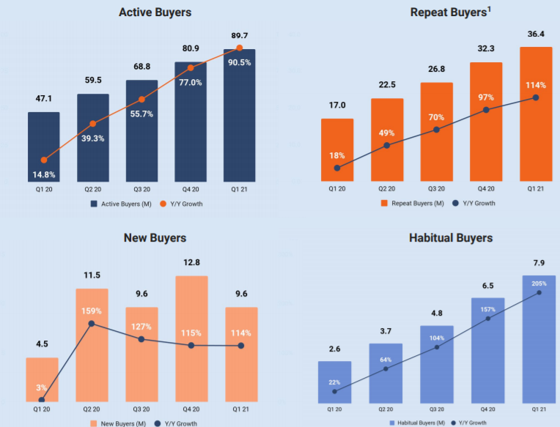
Investment Rational
Rational
Increase in sales via growth of active and habitual buyers
GMS increased from $1.8 billion to $3.1 billion, 132.3% increase, in the three months ended March 31, 2020
This was driven by an increase in both sellers and active buyers. As of March 31, 2021, habitual buyers, grew to 7.9 million, a 205% increase compared to March 31st , 2020
While this growth may slow down as more businesses open, Etsy has increased their number of habitual buyers during this time. As Etsy identifies one of their biggest growth factors to be from word of mouth, this may help keep sales increasing
Reverb’s high sales growth
Reverb, an online market for new and used musical gear and a subsidiary of Etsy, had Y/Y gross sales growth of ~50%, towering over the musical retail sales industry benchmark of 8%
Sources: ETSY 10-k, Etsy Annual Report
Notes:
Etsy competes with many platforms for buyers and sellers, relies on image and must undercut listing fees and marketplace revenue

Slide 9
Public Comparable
Public Company Comp Set
Company | TEV/Total Revenues LTM | TEV/EBITDA LTM | TEV/EBIT LTM | NTM TEV/Revenue | NTM TEV/EBITDA | NTM P/E
Stitch Fix, Inc. (NasdaqGS:SFIX) | 2.20x | NM | NM | 1.81x | NM | NM
Grubhub Inc. (NYSE:GRUB) | 3.10x | NM | NM | 2.62x | 36.88x | NM
Groupon, Inc. (NasdaqGS:GRPN) | 1.10x | 30.40x | NM | 1.33x | 8.16x | 49.86x
Wayfair Inc. (NYSE:W) | 2.00x | 31.80x | 47.10x | 1.87x | 34.68x | 63.17x
ContextLogic Inc. (NasdaqGS:WISH) | 2.30x | NM | NM | 1.73x | NM | NM
Overstock.com, Inc. (NasdaqGM:OSTK) | 1.00x | 31.70x | 43.10x | 1.01x | 19.56x | 34.86x
Farfetch Limited (NYSE:FTCH) | 9.10x | NM | NM | 6.93x | NM | NM
eBay Inc. (NasdaqGS:EBAY) | 3.90x | 11.50x | 14.60x | 3.63x | 10.67x | 14.53x
The RealReal, Inc. (NasdaqGS:REAL) | 6.70x | NM | NM | 4.66x | NM | NM
Amazon.com, Inc. (NasdaqGS:AMZN) | 4.00x | 26.40x | 56.70x | 3.33x | 21.19x | 57.58x
High | 9.1x | 31.8x | 56.7x | 6.93x | 36.88x | 63.17x
Low | 1.0x | 11.5x | 14.6x | 1.01x | 8.16x | 14.53x
Mean | 3.6x | 26.4x | 40.4x | 2.89x | 21.86x | 44.00x
Median | 2.7x | 30.4x | 45.1x | 2.25x | 20.37x | 49.86x
Etsy, Inc. (NasdaqGS:ETSY) | 9.6x | 33.9x | 35.8x | 8.30x | 29.10x | 47.36x

Slide 10
Discounted Cash Flow

Slide 11
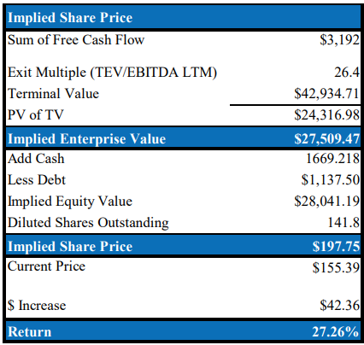
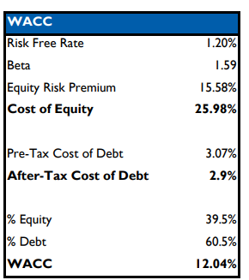
Discounted Cash Flow Outputs

Slide 12
Q&A

